Slide 1
F I Z I K A
7- sinf
MAVZU: TEKIS O‘ZGARUVCHAN HARAKATLANAYOTGAN JISM TEZLANISHINI ANIQLASH
(1- laboratoriya ishi)

Slide 2
Laboratoriya ishining maqsadi:
Qiya novdan dumalab tushayotgan sharchaning bosib o‘tgan yo‘li va harakat vaqtini o‘lchash orqali tekis tezlanuvchan harakatlanayotgan jism tezlanishini aniqlashni o‘rganish.

Slide 3
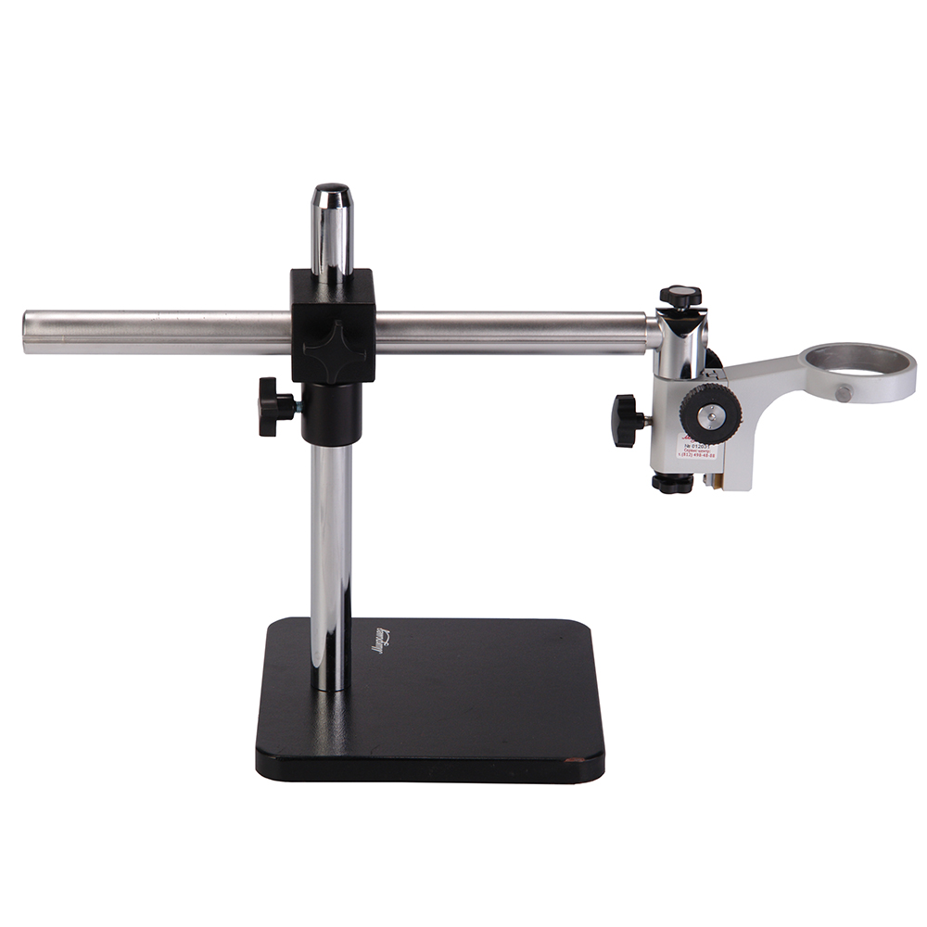
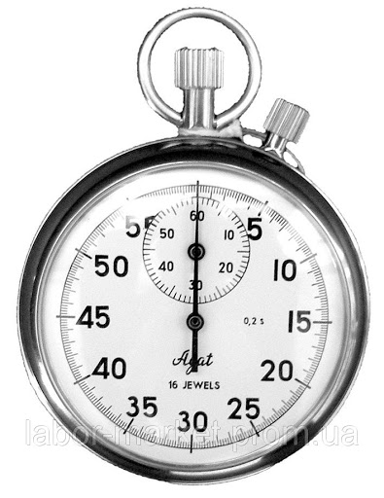
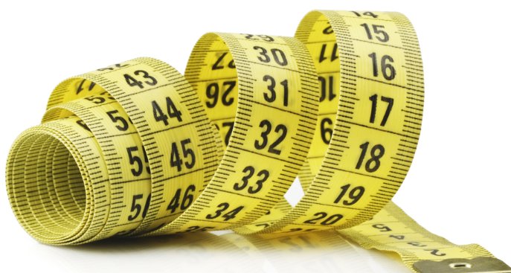
KERAKLI JIHOZLAR:
Metall nov, po‘lat sharcha, shtativ, metall silindr, o‘lchov tasmasi, sekundomer.

Slide 4
Laboratoriya ishining bajarilish tartibi:
1. Rasmda ko‘rsatilganidek, metall novni shtativga o‘rnatib metall silindrni novning quyi qismiga joylashtiramiz.

Slide 5
Laboratoriya ishining bajarilish tartibi:
2. Novning yuqori qismidan qo‘yib yuborilgan sharcha novning quyi uchidagi slindrga borib urilgunga qadar o‘tgan vaqtni sekundomer yordamida o‘lchaymiz.

Slide 6
Laboratoriya ishining bajarilish tartibi:
3. Xuddi shu tarzda tajribani 3 marta takrorlaymiz. O‘lchov tasmasi yordamida sharchaning bosib o‘tgan yo‘lini o‘lchab olamiz.

Slide 7
Laboratoriya ishining bajarilish tartibi:
$$s= \frac{{αt}^{2} }{2}$$
$$α= \frac{2S}{t^{2}}$$
$a_{1}$, $a_{2}$, ${ a}_{2}$
$$a_{1} = \frac{2S_{1}}{{t_{1}}^{2}}$$

Slide 8
Laboratoriya ishining bajarilish tartibi:
$$α_{o′rt}=\frac{a_{1}\text{+} a_{2}\text{ + }a_{3}}{3}$$
$$∆ α_{n}=\left|α_{o′rt}−α_{n}\right|$$
$$∆{ α}_{o′rt}=\frac{{∆a}_{1}\text{+}∆a_{2}\text{ +}∆a_{3}}{3}$$
$$ε=\frac{∆{ α}_{o′rt}}{α_{o′rt}}$$

Slide 9
NATIJALAR JADVALI
T/r | S, m | $$t_{1}, s$$ | $$t_{2}, s$$ | $$t_{3}, s$$ | $a_{1}$, $\frac{m}{s^{2}}$ | $a_{1}$, $\frac{m}{s^{2}}$ | $a_{1}$, $\frac{m}{s^{2}}$ | $a_{o^{′}rt}$, $\frac{m}{s^{2}}$ | $∆{ α}_{o′rt},$ $\frac{m}{s^{2}}$ | $$ε, \%$$
1
2
3

Slide 10
NATIJALAR JADVALI
T/r | S, m | $$t_{1}, s$$ | $$t_{2}, s$$ | $$t_{3}, s$$ | $a_{1}$, $\frac{m}{s^{2}}$ | $a_{1}$, $\frac{m}{s^{2}}$ | $a_{1}$, $\frac{m}{s^{2}}$ | $a_{o^{′}rt}$, $\frac{m}{s^{2}}$ | $∆{ α}_{o′rt},$ $\frac{m}{s^{2}}$ | $$ε, \%$$
1 | 0,67 | 1,60 | 1,50 | 1,55 | 0,5 | 0,6 | 0,56 | 0,55 | 0,04 | 7
2 | 0,67 | 1,20 | 1,18 | 1,55 | 0,93 | 0,96 | 0,89 | 0,93 | 0,02 | 3
3 | 0,67 | 0,85 | 0,80 | 0,78 | ? | ? | ? | ? | ? | ?

Slide 11
Mustaqil bajarish uchun topshiriqlar:
Jadvalni oxirigacha to‘ldiring. Natijalarni tahlil qiling va xulosa chiqaring.
Novning qiyaligi oshganda nima sababdan tezlanishning qiymati oshib boradi?

