Slide 1
F I Z I K A
7- sinf
MAVZU: MASALALAR YECHISH

Slide 2
Masalalar yechish
1. Jism XOY koordinata tekisligida 𝒳=3+2t(m), 𝑦=6-3t(m) tenglamalarga muvofiq harakatlanmoqda. Jism 0𝒳 o‘qini koordinata boshidan qanday masofada (m) kesib o‘tadi?

Slide 3
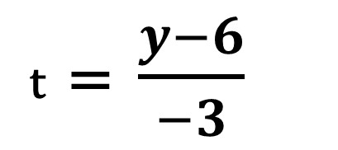
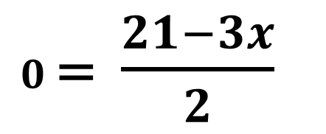
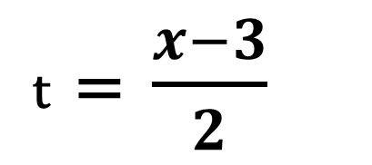
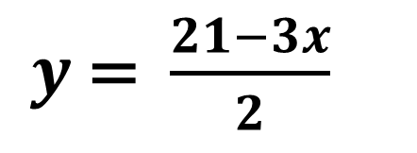
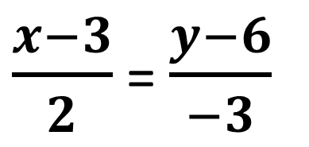
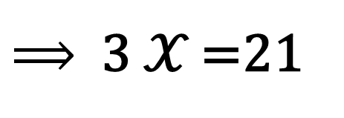
Masalalar yechish
Berilgan:
𝑦, m
Yechilishi:
6
t = $\frac{x−3}{2}$
𝒳 =3+2t
𝒳 =3+2t
𝑦 =6-3t
𝑦 =6-3t
t = $\frac{y−6}{−3}$
𝒳 = ?
𝒳, m
0
$\frac{x−3}{2}$ = $\frac{y−6}{−3}$
3
𝒳
-3𝒳 +9 = 2$y −$12
$y$= $\frac{21−3x}{2}$
$⟹$ $y$= 0
$0$= $\frac{21−3x}{2}$
$⟹$3 𝒳 =21
Javob:
𝒳 = 7 m

Slide 4
Masalalar yechish
2. Agar ikki jismning harakat tenglamasi mos ravishda ${\text{𝒳}}_{1}$=90-t, ${\text{𝒳}}_{2}$=2t bo‘lsa, ularning uchrashuv joyi va vaqtini aniqlang.

Slide 5
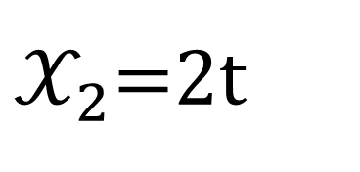
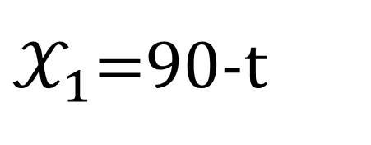
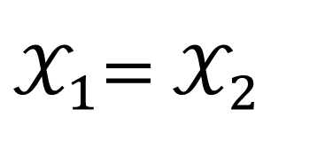
Masalalar yechish
Berilgan:
Yechilishi:
${\text{𝒳}}_{1}$=90-t
${\text{𝒳}}_{1}$= ${\text{𝒳}}_{2}$
90-t = 2t
${\text{𝒳}}_{2}$=2t
90 = 3t
𝒳 = ?
t = 30 s
t = ?
${\text{𝒳}}_{1}$= ${\text{𝒳}}_{2}$= 𝒳 = 2 $∙$30 s = 60 m
Javob:
𝒳 = 60 m , t = 30 s

Slide 6
Masalalar yechish
3. Elektropoyezd yo‘lning uchdan bir qismini 5 m/s tezlik bilan, qolgan qismini esa 72 km/h tezlik bilan bosib o‘tgan bo‘lsa, uning o‘rtacha tezligini toping.

Slide 7
Masalalar yechish
4. Jism yo‘lning birinchi yarmini 4 m/s tezlik bilan, qolgan yarmini $θ_{2}$ tezlik bilan bosib o‘tdi. Agar o‘rtacha tezlik 4,8 m/s bo‘lsa, $θ_{2}$ tezlik nechaga teng bo‘lgan?

Slide 8
Mustaqil bajarish uchun topshiriqlar:
1. Boshlang‘ich tezligi 10 m/s bo‘lgan jism 4 $\frac{m}{{ s}^{2}}$ tezlanish bilan tekis tezlanuvchan harakat qilmoqda. Jism harakatining yo‘l grafigini chizing.
2. Jism bir xil vaqt oraliqlarida 0 m/s, 1 m/s, 2 m/s va h.k. tezlikka ega bo‘lsa, uning harakatini tekis o‘zgaruvchan haratat desa bo‘ladimi? Sababini tushuntiring.

