Slide 1
F I Z I K A
7- sinf
MAVZU: O‘TILGAN MAVZULAR BO‘YICHA TAKRORLASH

Slide 2
KRASSVORD
1
V
E
K
T
O
R
T
2
K
I
N
E
M
A
K
A
E
T
I
3
Z
I
K
Z
I
Ch
L
4
O‘
L
Y
L
6
5
A
E
K
T
I
T
R
A
Y
O
R
Y
A
M
D
D
I
Y
N
U
T
A
O
N
Q
7
T
E
K
I
S
I
8
K
O‘
Ch
I
Sh
Sh

Slide 3
TAKRORLASH
Formulalar | Nomi
$s=$ $θ_{o^{′}rta}$ $∙t$
Notekis harakatda bosib o‘tilgan yo‘l formulasi.
$$θ_{o′rt}= \frac{ α \text{t}}{2}$$
Tekis o‘zgaruvchan harakatda o‘rtacha tezlikni topish formulasi.
$$s= \frac{{αt}^{2} }{2}$$
Boshlang‘ich tezliksiz tekis tezlanuvchan harakatda bosib o‘tilgan yo‘l formulasi.
$$s=θ_{0}∙t+\frac{{αt}^{2} }{2}$$
Tekis o‘zgaruvchan harakatda bosib o‘tilgan yo‘l formulasi.

Slide 4
TEZLIK GRAFIGI
$$θ, m/s$$
$$t$$
$$s= \frac{{αt}^{2} }{2}$$
A
B
$$12$$
$$θ=αt$$
$$8$$
$$αt$$
$$s= \frac{{αt}^{2} }{2}$$
$$4$$
$$0$$
$$2$$
$$4$$
$$6$$
C
$$t , s$$

Slide 5
TEZLIK GRAFIGI
$$θ, m/s$$
$$t$$
B
$$s=θ_{0}∙t+\frac{{αt}^{2} }{2}$$
$$αt$$
$$s_{2} = \frac{{αt}^{2} }{2}$$
$$θ_{0}$$
C
$s_{1}=$ $θ_{0}$ $∙t$
$θ_{0}$
$$t , s$$
$$0$$
D

Slide 6
YO‘L GRAFIGI
s$, m$
25
$$α=2 m/s^{2}$$
$$s= \frac{{αt}^{2} }{2}$$
$$16$$
Parabola
9
4
1
$$0$$
1
$$2$$
$$3$$
$$4$$
$$5$$
$$t , s$$

Slide 7
Masalalar yechish
1. Harakatlanayotgan jism tezligining o‘zgarishi grafik tarzda berilgan. t = 1 s paytdagi uning bosib o‘tgan yo‘lini toping.
$$θ, m/s$$
6
4
2
$$0$$
$$2$$
$$8$$
$$t , s$$
$$4$$
$$6$$

Slide 8
Masalalar yechish
$$θ, m/s$$
$$θ_{o}=0$$
$$α=\frac{θ{−θ}_{0}}{t}$$
6
t $=4 s$
$$θ=5 m/s$$
4
$α=\frac{5 \frac{m}{s} − 0}{4 s}$ =
1,25 $\frac{m}{{ s}^{2}}$
2
$$0$$
$$2$$
$$4$$
$$6$$
$$8$$
$$t , s$$
$$s= \frac{{αt}^{2} }{2}$$
$$= \frac{{1,25 \frac{m}{{ s}^{2}} ∙ (1 s)}^{2} }{2} =0,625 m$$
Javob: s = 0,625 m = 62,5 cm

Slide 9
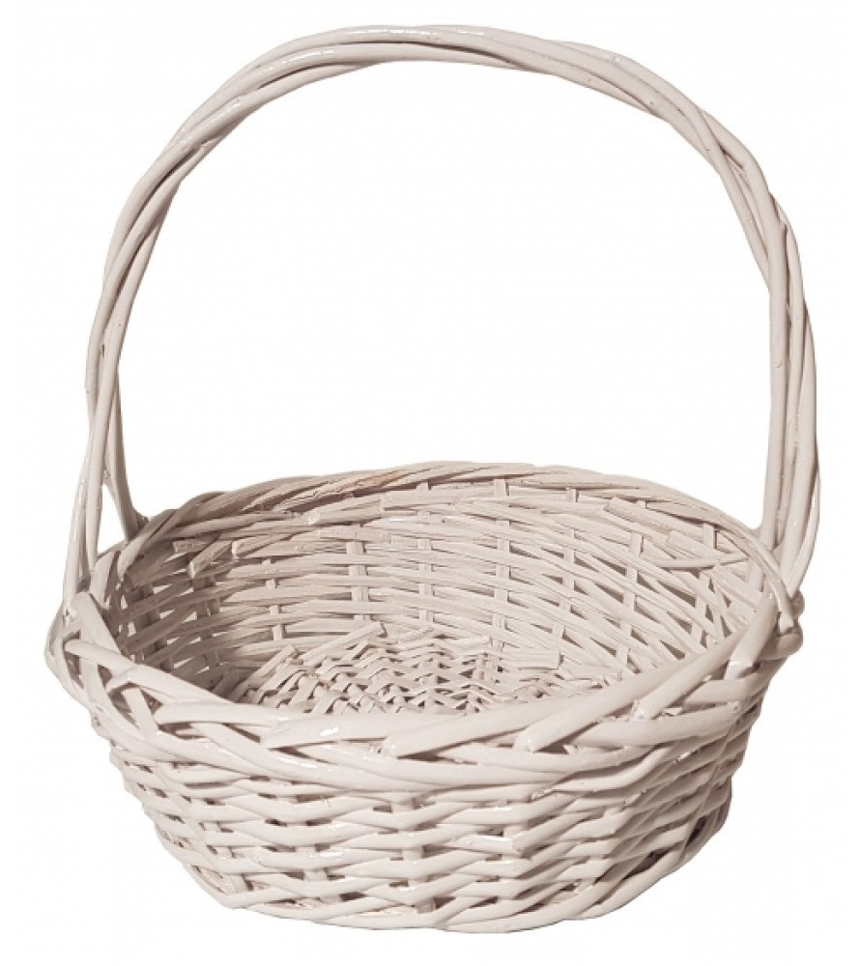
7 – MASHQ (3)
3. Jism joyidan qo‘zg‘alib, 1 $\frac{m}{{ s}^{2}}$ tezlanish bilan tekis tezlanuvchan harakat qilmoqda. Jism harakatining yo‘l grafigini chizing.

Slide 10
7 – MASHQ (3)
Kattaliklar
Birliklar

Slide 11
D o m i n o
1
Start
F = $ρ$gV
Tezlik
5
Zichlik
2
$a$= $\frac{θ−θ_{0}}{t}$
Bosim
6
A = F S
Tezlanish
3
Arximed
kuchi
$θ$= $\frac{S}{t}$
Ish
7
F = mg
4
P = $\frac{F}{S}$
Kinetik
energiya
E = mgh
Kuch
8

Slide 12
D o m i n o
1
Start
8
F = $ρ$gV
Tezlik
Zichlik
4
$a$= $\frac{θ−θ_{0}}{t}$
Bosim
3
A = F S
Tezlanish
2
$θ$= $\frac{S}{t}$
Ish
Arximed
kuchi
7
F = mg
5
P = $\frac{F}{S}$
Kinetik
energiya
6
E = mgh
Kuch

Slide 13
D o m i n o
1
Start
8
F = $ρ$gV
Tezlik
Zichlik
4
$a$= $\frac{θ−θ_{0}}{t}$
Bosim
3
A = F S
Tezlanish
2
$θ$= $\frac{S}{t}$
Ish
Arximed
kuchi
7
F = mg
5
P = $\frac{F}{S}$
Kinetik
energiya
6
E = mgh
Kuch

Slide 14
1
Start
8
k ning
m/s
C
4
3
$\frac{m}{s^{2}}$
Tezlanish
Pa
Ish
Kuchlan-
ganlik
N $\frac{m^{2}}{C^{2}}$
2
Tezlik
J
7
6
Tok kuchi
N/C
5
Bosim
A
9
Zaryad
miqdori
10
Elektr
sig‘im
F
Barakalla

Slide 15
1
Start
6
k ning
m/s
C
2
7
$\frac{m}{s^{2}}$
Tezlanish
Pa
Ish
Kuchlan-
ganlik
N $\frac{m^{2}}{C^{2}}$
3
Tezlik
J
8
4
Tok kuchi
N/C
9
Bosim
A
5
Zaryad
miqdori
10
Elektr
sig‘im
F
Barakalla

Slide 16
D o m i n o
1
Start
8
F = $ρ$gV
Tezlik
Zichlik
4
$a$= $\frac{θ−θ_{0}}{t}$
Bosim
3
A = F S
Tezlanish
2
$θ$= $\frac{S}{t}$
Ish
Arximed
kuchi
7
F = mg
5
P = $\frac{F}{S}$
Kinetik
energiya
6
E = mgh
Kuch

Slide 17
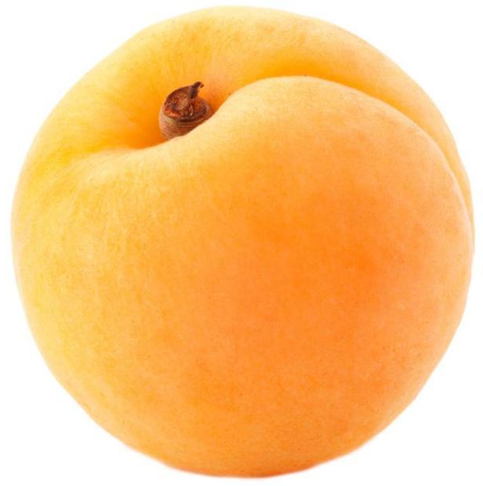
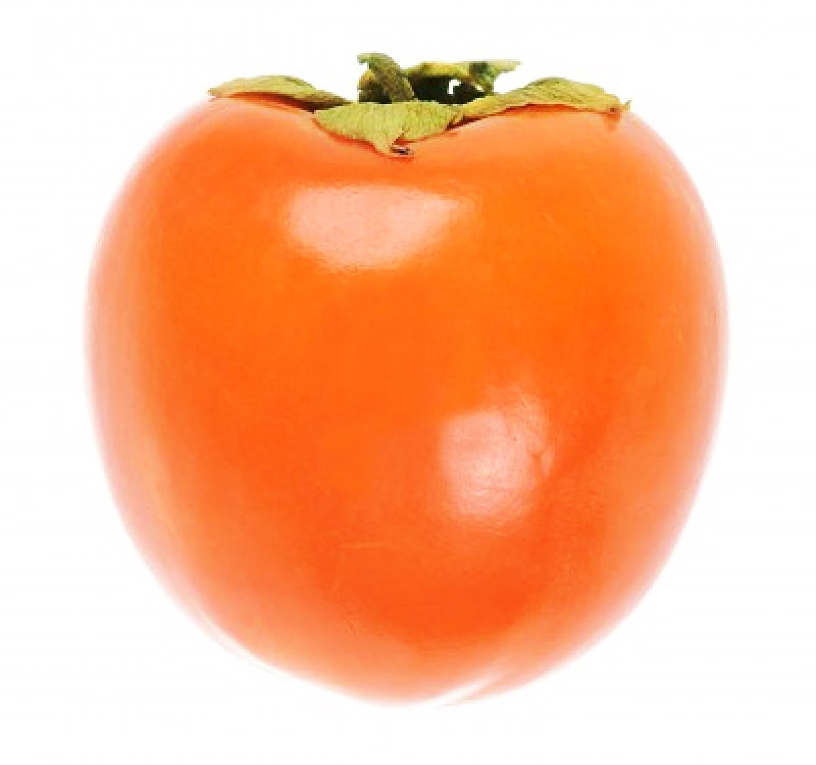
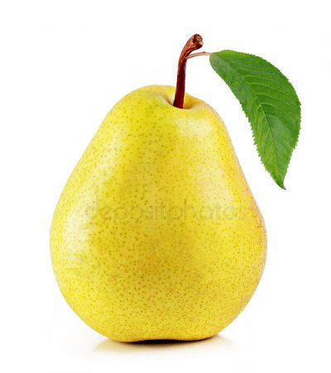
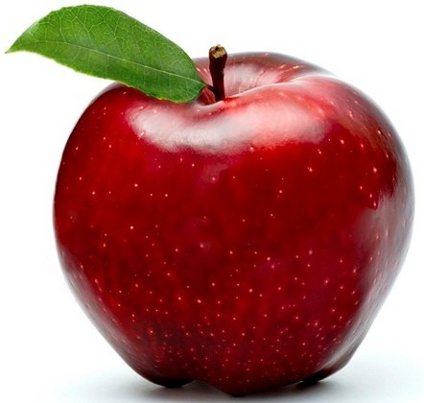
F
g
N
m/s
$$θ$$
t
S
dm
$$ρ$$
$$\frac{m}{s^{2}}$$
E
J
$$a$$
$$m^{3}$$
P
Pa

Slide 18
F
g
N
m/s
$$θ$$
t
S
dm
$$ρ$$
$$\frac{m}{s^{2}}$$
E
J
$$a$$
$$m^{3}$$
P
Pa

Slide 19
Masalalar yechish
4. Jism dastlab 3 s davomida 2 m/s tezlik bilan tekis, so‘ngra 5 s davomida 2 $\frac{m}{{ s}^{2}}$ tezlanish bilan tekis tezlanuvchan harakat qildi. Jismning bosib o‘tgan yo‘lini toping.

Slide 20
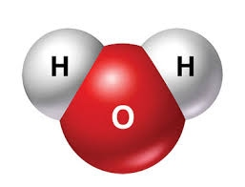
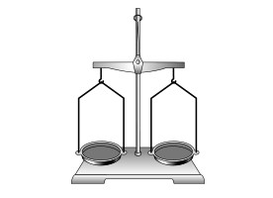
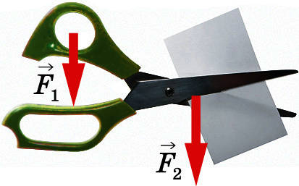
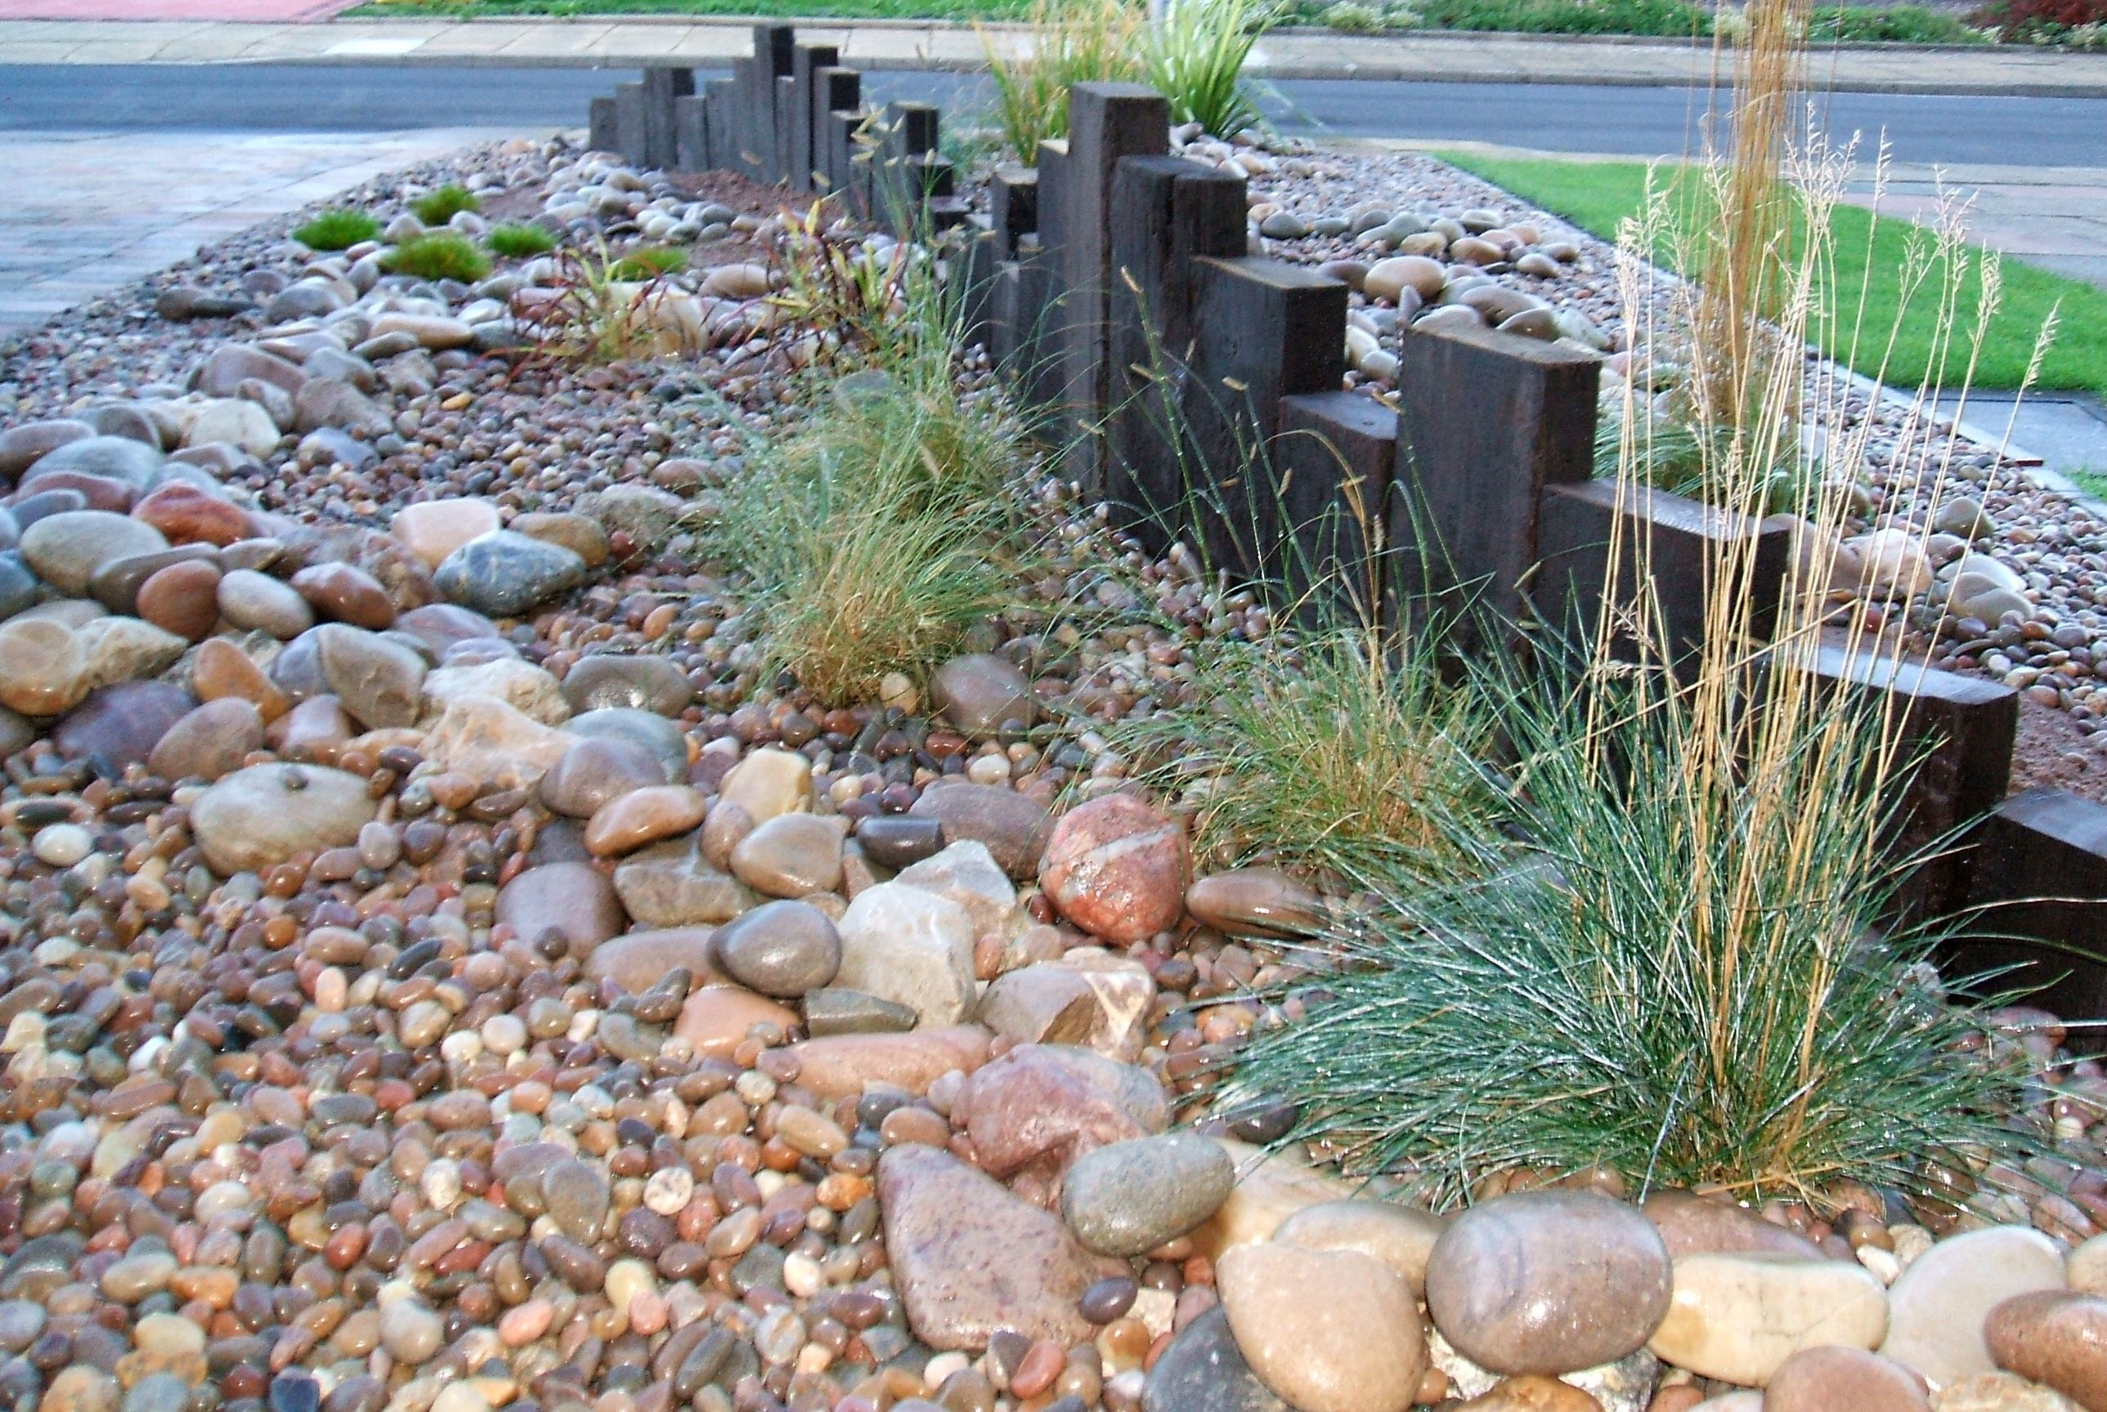
D o m i n o
1
Oddiy mexanizm
Start
5
Barakalla
2
Tarozi
6
Shtangen-
sirkul
3
Menzurka
7
Fizik jism
Dinamo-
metr
8
4
Molekula

Slide 21
D o m i n o
Start
Menzurka
Shtangen-
sirkul
Tarozi

Slide 22
D o m i n o
1
Start
Menzurka
F = $ρ$gV
5
Zichlik
2
$a$= $\frac{θ−θ_{0}}{t}$
Bosim
6
A = F S
Tezlanish
3
Arximed
kuchi
$θ$= $\frac{S}{t}$
Ish
7
F = mg
4
P = $\frac{F}{S}$
Kinetik
energiya
E = mgh
Kuch
8

Slide 23
Mustaqil bajarish uchun topshiriqlar:
1. Jism 5 s davomida 4 m/s tezlik bilan tekis harakat qildi. So‘ngra 5 s davomida 2 $\frac{m}{{ s}^{2}}$ tezlanish bilan tekis tezlanuvchan harakat qildi. Jismning bosib o‘tgan yo‘lini ikki usul yordamida hisoblang.
2. Ushbu bobda o‘rgangan barcha formula va ularning nomlarini daftaringizga klasster usulda yozib chiqing.

