Slide 1
F I Z I K A
7- sinf
MAVZU: TO‘G‘RI CHIZIQLI TEKIS HARAKAT TEZLIGI

Slide 2
ASOSIY TUSHUNCHALAR
1
2
3
4
Tezlikni aniqlash
Tezlik birligi
Tezlikni o‘lchash
Masalalar yechish

Slide 3
Harakat turlari
Tekis harakat
$S_{1}$=5 m
$$θ$$
$S_{2}$=5 m
$S_{3}$=5 m
$t_{1}$=1 s
$t_{2}$=1 s
$t_{3}$=1 s
$S_{1}$=5 m
Notekis harakat
$$θ$$
$S_{2}$=10 m
$S_{3}$=15 m
$t_{1}$=1 s
$t_{2}$=1 s
$t_{3}$=1 s

Slide 4
1
2
1
2
SOVRIN
$$E=\frac{{mθ}^{2}}{2}$$
E = mgh
1 atm.bos
F = $ρ$ g V
F = m g
N$=\frac{A}{t}$
$$ρ=\frac{m}{V}$$
P $=\frac{F}{S}$

Slide 5
1
2
E = mgh
$$E=\frac{{mθ}^{2}}{2}$$
F = $ρ$ g V
N$=\frac{A}{t}$
P $=\frac{F}{S}$

Slide 6
1
2
Potensial energiya formulasi
Kinetik energiya formulasi
Arximed kuchi formulasi
Quvvat formulasi
Bosim formulasi

Slide 7
1
2
$$ρ=\frac{m}{V}$$
P $=\frac{F}{S}$
$$E=\frac{{mθ}^{2}}{2}$$
F = $ρ$ g V
N$=\frac{A}{t}$
E = mgh
F = m g

Slide 8
1
2
E = mgh
$$E=\frac{{mθ}^{2}}{2}$$
F = $ρ$ g V
N$=\frac{A}{t}$
P $=\frac{F}{S}$

Slide 9
1
2
1
2
SOVRIN
$$E=\frac{{mθ}^{2}}{2}$$
E = mgh
1 atm.bos
F = $ρ$ g V
F = m g
N$=\frac{A}{t}$
$$ρ=\frac{m}{V}$$
P $=\frac{F}{S}$

Slide 10
Harakat turlari
$S_{1}$=5 m
$S_{2}$=10 m
$S_{3}$=15 m
$t_{1}$=1 s
$t_{2}$=1 s
$t_{3}$=1 s

Slide 11
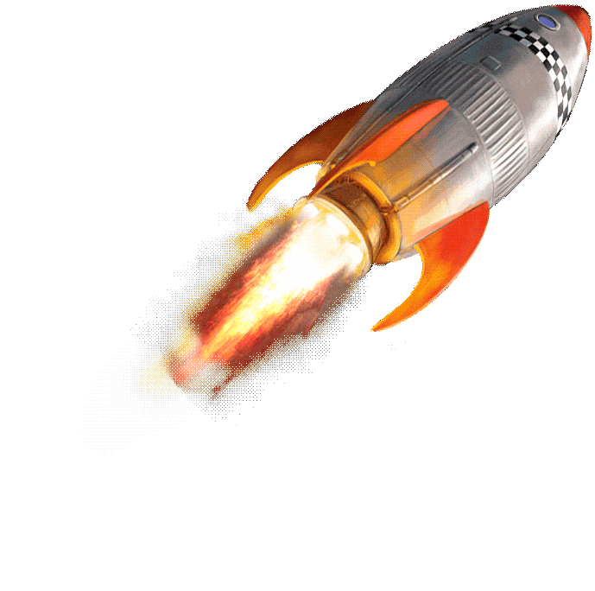
TURLI TEZLIKDAGI HARAKATLAR
$t_{1}$=1 min
$t_{2}$=1 min
$S_{1}$=100 m
$S_{2}$= 500 km
$t_{3}$=1 min
$S_{3}$= 18 mln km

Slide 12
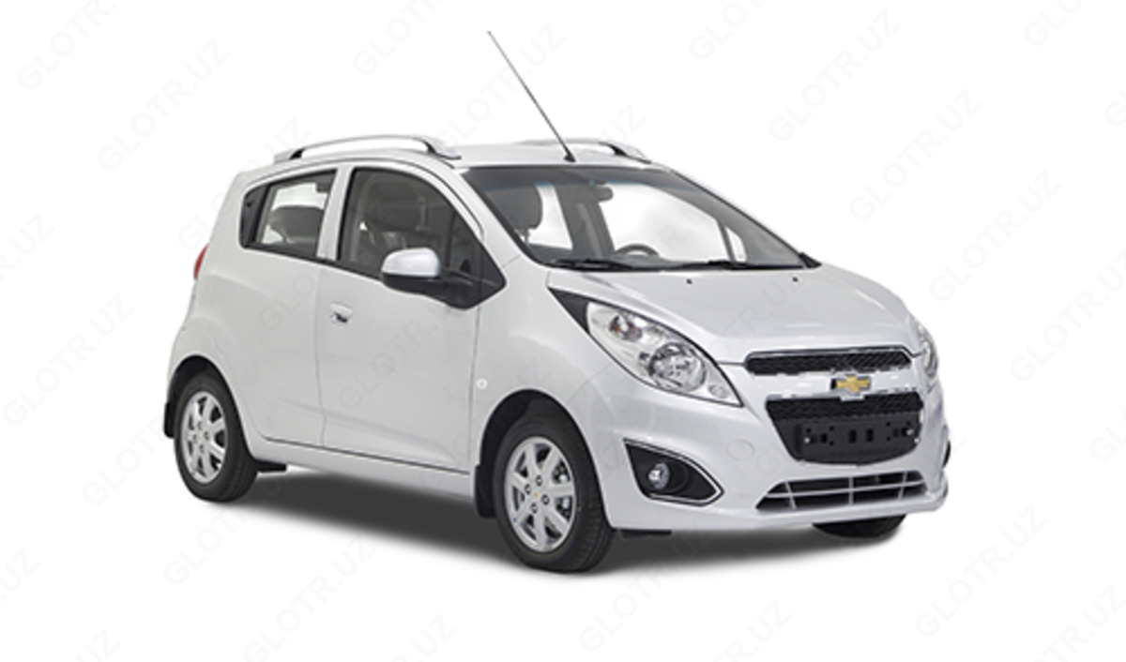
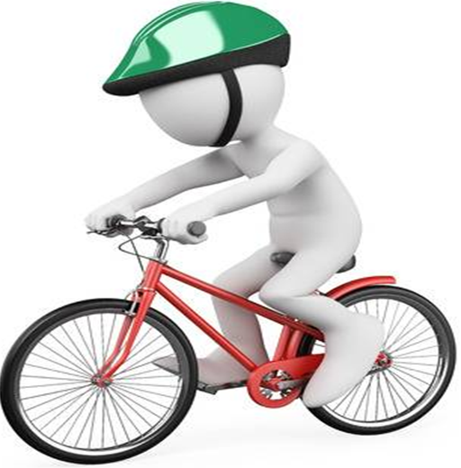
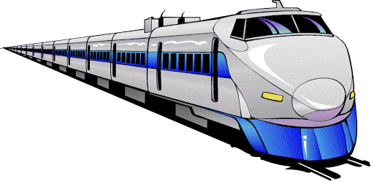
JISMLARNING TURLI TEZLIKDAGI HARAKATI

Slide 13
JISMLARNING TURLI TEZLIKDAGI HARAKATI
18 km/h
90 km/h
900 km/h
144 km/h
36 km/h

Slide 14
TEZLIKNI ANIQLASH
Jismning tekis harakatidagi tezligi jism bosib o‘tgan yo‘lning shu yo‘lni bosib o‘tish uchun ketgan vaqtga nisbati bilan aniqlanadi.
$$θ=\frac{s}{t}$$

Slide 15
TEZLIKNI ANIQLASH
Jismni vaqt birligidagi bosib o‘tilgan yo‘liga son jihatdan teng bo‘lgan kattalikka tezlik deb ataladi.
t $=\frac{s}{θ}$
$s=θ$ t

Slide 16
TEZLIK BIRLIGI
Agar tezligi 6 m/s bo‘lsa, jism 1 s vaqtda 6 m masofani bosib o‘tadi.
Tezlikning hosilaviy birliklari:
km/h,
km/min,
km/s,
cm/s,
cm/min…

Slide 17
Tekis harakat
XBSda tezlikning birligi sifatida m/s qabul qilingan.

Slide 18
TEZLIK BIRLIGI
1 m/s =
3,6 km/h,
1 m/s =
0,06 km/min,
1 km/s =
1000 m/s,
1 m/s =
100 cm/s

Slide 19
Xalqaro birliklar sistemasi (XBS)
$$θ=90\frac{km}{h}=$$
$90∙\frac{1000 m}{3600 s}$ = $90∙\frac{5 m}{18 s}=\text{25} \frac{m}{s}$
$$θ=10\frac{m}{s}=$$
$10∙$ 3,6 km/h =36 $\frac{km}{h}$

Slide 20
Xalqaro birliklar sistemasi (XBS)
$$θ=360\frac{km}{h}=$$
$360\frac{1000 m}{3600 s}$ = $\frac{3600 m}{36 s}$ = 100 m/s
$$θ=900\frac{km}{h}=$$
$900\frac{1000 m}{3600 s}$ = $\frac{9000 m}{36 s}$ = 250 m/s
$$θ=20\frac{m}{s}=$$
$20 \frac{3600 km}{1000 h }$ = $\frac{2 ∙36km}{ h }$ = 72 km/h

Slide 21
TEZLIKNI O‘LCHASH
Harakatlanayotgan jismlarning tezligi maxsus asboblar yordamida o‘lchanadi.
Masalan, avtomobil, kema, samolyot, tezligi spidometr yordamida o‘lchanadi.
Inglizcha speed - tezlik, lotincha metreo- -o‘lchash degan ma’noni bildiradi.

Slide 22
2- mashq (1)
1. Tezliklarni km/h da ifodalang:
2 m/s, 5 m/s, 20 m/s, 50 m/s
$$θ=2\frac{m}{s}=$$
$2 \frac{3600 km}{1000 h }$ = $\frac{2 ∙36km}{ 10 h }$ = 7,2 km/h
$$θ=5\frac{m}{s}=$$
$5 \frac{3600 km}{1000 h }$ = $\frac{5 ∙36km}{ 10 h }$ = 18 km/h

Slide 23
2- mashq (1)
$$θ=20\frac{m}{s}=$$
$20 \frac{3600 km}{1000 h }$ = $\frac{2 ∙36km}{ h }$ = 72 km/h
$$θ=50\frac{m}{s}=$$
$50 \frac{3600 km}{1000 h }$ = $\frac{5 ∙36km}{ h }$ = 180 km/h
Javob: $2\frac{m}{s}=7,2\frac{km}{h}, 5\frac{m}{s}=18\frac{km}{h}$,
$20\frac{m}{s}=72\frac{km}{h}$, $50\frac{m}{s}=180\frac{km}{h}$

Slide 24
2- mashq (2)
2. Metro eskalatorining uzunligi 18 m. U odamni 12 sekundda yuqoriga olib chiqadi. Eskalatorda turgan odamning tezligini toping.

Slide 25
2- mashq (2)
Berilgan:
Formulasi:
Yechilishi:
S = 18 m
$$θ=\frac{s}{t}$$
$θ=\frac{18 m}{12 s}$= 1,5 m/s
t = 12 m
$$θ= ?$$
Javob: $θ=$1,5 m/s

Slide 26
2- mashq (3)
3. Velosiped tekis harakat qilib, 15 minutda 4,5 km masofani bosib o‘tdi. Uning tezligini m/s hisobida toping.

Slide 27
2- mashq (3)
Berilgan:
XBS:
Formulasi:
t = 15 min
= 15 $∙$60 s =900 s
$$θ=\frac{s}{t}$$
S = 4,5 km
= 4,5 $∙1000$ s = 4500 m
$$θ= ?$$
Yechilishi:
$θ=\frac{4500 m}{900 s}$= 5 m/s
Javob: $θ=$5 m/s

Slide 28
2- mashq (3)
Berilgan:
Formulasi:
Yechilishi:
t = 15 min
$$θ=\frac{s}{t}$$
$θ=\frac{4,5 km}{15 min}$= 0,3 km/min
S = 4,5 km
$$θ= ?$$
$θ=$ 0,3 km/min= 0,3 $∙\frac{1000 m}{60 s}$ = 5 m/s
Javob: $θ=$5 m/s

Slide 29
2- mashq (4)
4. Tekis harakat qilayotgan avtomobil 30 minutda 40 km masofani bosib o‘tdi. Avtomobil tezligini toping.

Slide 30
2- mashq (4)
Berilgan:
XBS:
Formulasi:
S = 40 km
$$θ=\frac{s}{t}$$
t = 30 min
= 0,5 h
$$θ= ?$$
Yechilishi:
$θ=\frac{40 km}{0,5 h}$= 80 km/h$≈22 m/s$
Javob: $θ=80 km/h$

Slide 31
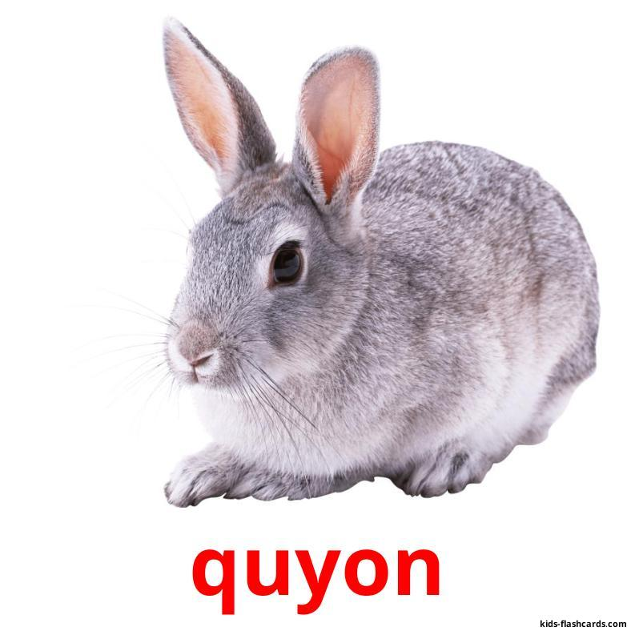
Mustaqil bajarish uchun topshiriqlar:
1.
$$θ=20 m/s$$
$$θ=54 km/h$$
Savol: Qaysi birining tezligi katta va necha marta?

Slide 32
Mustaqil bajarish uchun topshiriqlar:
2. Oqimning tezligi 0,5 m/s bo‘lgan daryoda oqayotgan sol 15 km yo‘lni qancha vaqtda bosib o‘tadi?

Slide 33
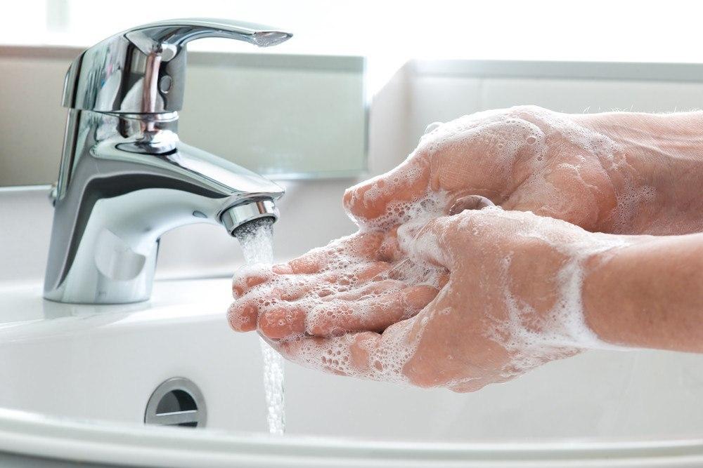
Aziz o‘quvchilar,
Shaxsiy gigiyena qoidalariga amal qiling
va qo‘lingizni tez-tez sovunlab yuvishni unutmang!

