Slide 1
F I Z I K A
7- sinf
MAVZU: MASALALAR YECHISH
t = $\frac{s}{θ}$
$\vec{θ_{1}}$ + $\vec{θ_{2}}$ = $\vec{θ}$
$θ$= $\frac{s}{t}$

Slide 2
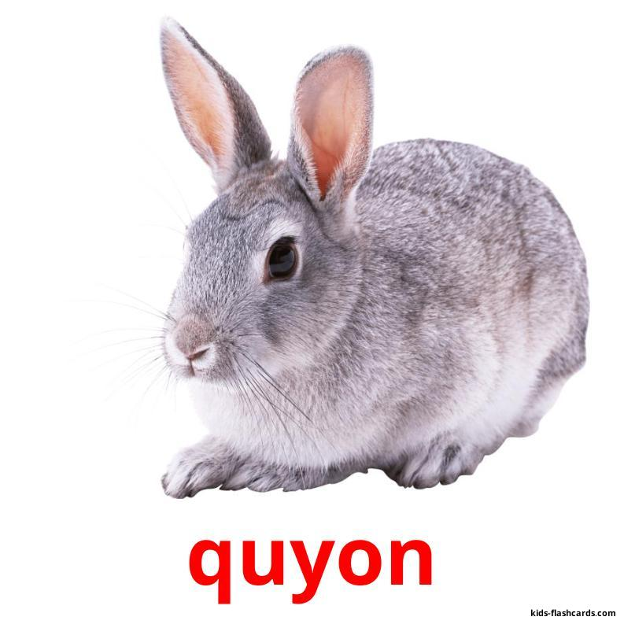
BERILGAN TOPSHIRIQLARNI TEKSHIRISH
1.
$$θ=20 m/s$$
$$θ=54 km/h$$
Savol: Qaysi birining tezligi katta va necha marta?

Slide 3
BERILGAN TOPSHIRIQLARNI TEKSHIRISH
1.
$$θ_{q} =54 km/h$$
$θ_{d}$= 20 m/s
$54 \frac{km}{h}=54\frac{1000 m}{3600 s}$ = 15 $\frac{m }{s}$
$θ_{d}=$20 m/s
20 m/s
$$>$$
15 m/s
$$θ_{q}=15 m/s$$
$θ_{d}$ = $\frac{4}{3}$ $θ_{q}$= 1,(3)
$θ_{q}$ = $\frac{3}{4}$ $θ_{d}$
Javob: Delfinning tezligi quyonnikidan katta ekan.

Slide 4
BERILGAN TOPSHIRIQLARNI TEKSHIRISH
2. Oqimning tezligi 0,5 m/s bo‘lgan daryoda oqayotgan sol s yo‘lni qancha vaqtda bosib o‘tadi?
Formulasi :
Yechilishi :
Berilgan:
$θ$= 0,5 m/s
$θ$= $\frac{s}{t}$
t = $\frac{15000 m}{0,5 m/s}$= 30 000 s
S = 15 km =15000 m
t = $\frac{s}{θ}$
$t$= ?
Javob: t = 500 min= 8,3 h

Slide 5
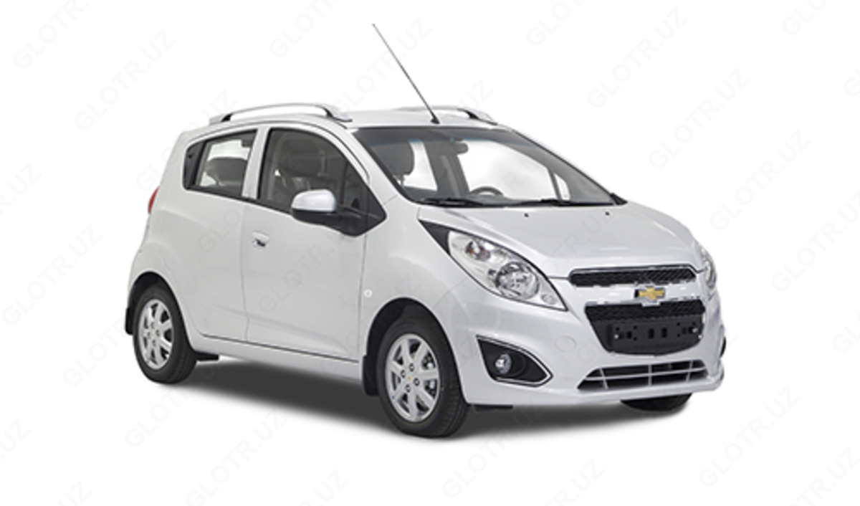
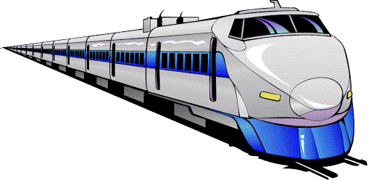
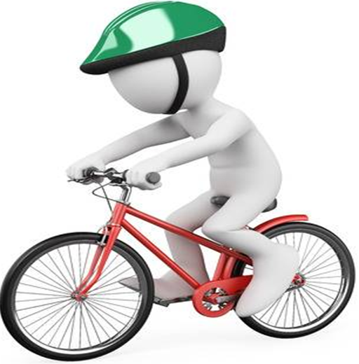
T O P SH I R I Q
Tezliklarni m/s da ifodalang.
18 km/h=
5 m/s
90 km/h=
25 m/s
900 km/h=
250 m/s
36 km/h=
10 m/s
144 km/h=
40 m/s

Slide 6
MASALALAR YECHISH
1. 21,6 km/h necha m/s bo‘ladi?
Berilgan:
$$θ=21,6 km/h$$
$$θ= ?(\frac{m}{s})$$
$$21,6\frac{km}{h}=21,6\frac{1000 m}{3600 s}$$
= 21,6 $\frac{1 }{3,6}$ $\frac{m }{s}$ = 6 m/s
Javob: $θ= 6$m/s

Slide 7
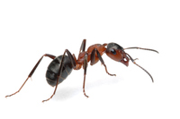
MASALALAR YECHISH
2. 9 m uzunlikdagi ip boshidan jo‘nagan chumoli ip oxiriga kelguncha 5 daqiqa o‘tdi. Chumolining tezligini toping (cm/s).
$$θ= ?$$

Slide 8
MASALALAR YECHISH
Berilgan:
XBS:
Formulasi :
S $=9 m$
$θ$= $\frac{s}{t}$
t $=5 min$
$5∙60 s=$300 s
$θ= ?(cm/s$)
Yechilishi :
$θ$= $\frac{9 m}{300 s}$ = $\frac{ 900 cm}{300 s}$ = 3 cm/s
Javob: $θ= 3 c$m/s

Slide 9
MASALALAR YECHISH
3. 1 m/s tezlik kattami yoki 1 km/h tezlikmi?
$$<, >, =$$
1 m/s
1 km/h

Slide 10
MASALALAR YECHISH
Berilgan:
XBS:
$θ_{1}$= 1 m/s
$1\frac{km}{h}=1\frac{1000 m}{3600 s}$ = $\frac{1 }{3,6}$ $\frac{m }{s}$
$θ_{2}$= 1 km/h
$1\frac{m}{s}=1∙$ 3,6 km/h = 3,6 km/h
$θ_{1}$ ? ($> < =) θ_{2}$
$1\frac{m}{s}=$ 3,6 km/h
1m/s
$$>$$
1 km/h
Javob: 1m/s $>$ 1 km/h

Slide 11
MASALALAR YECHISH
4. Reaktiv samolyot 340 m/s tezlik bilan tekis uchganligi ma’lum bo‘lsa, uning to‘g‘ri chiziqli trayektoriya bo‘ylab 0,2 soat ichidagi ko‘chishi modulini toping.

Slide 12
MASALALAR YECHISH
Berilgan:
XBS:
Formulasi :
$$θ=340 m/s$$
$θ$= $\frac{s}{t}$
t $=0,2 soat (h)$
$72$0 s
S = $θ t$
S $=L=?$
Yechilishi :
S = 340 m/s $∙720 s$ = 244800 m
Javob: S $=244800m=244,8 km=2,4 {∙10}^{5}$ m

Slide 13
MASALALAR YECHISH
5. Mashina dastlabki 5 daqiqada 600 m yo‘lni bosib o‘tdi. Agar u shu tezlik bilan harakatlansa, 0,5 soatda qancha yo‘lni bosib o‘tadi?

Slide 14
MASALALAR YECHISH
Berilgan:
Formulasi:
$t_{1}$= 5 min= 300 s
$θ$= $\frac{s}{t}$
S = $θ t$
$s_{1}$= 600 m
$s_{1}$= $θ_{1}$ $t_{1}$
$s_{2}$= $θ_{2}$ $t_{2}$
$θ_{1}$ = $θ_{2}$
$θ_{1}$ = $θ_{2}$
$s_{2}$= $θ_{2}$ $t_{2}$ = $\frac{s_{1}}{t_{1}}$ $t_{2}$
$t_{2}$= 0,5 h(soat)= 1800 s
$s_{2}$= ?
Yechilishi :
$s_{2}$= $\frac{600 m}{300 s} 1800 s$ = 3600 m
Javob: $s_{2}$= 3600 m= 3,6 km

Slide 15
MASALALAR YECHISH
6. 18 km/h tezlik bilan tekis harakat qilayotgan poyezd uzunligi 630 m bo‘lgan ko‘prikdan 2,5 minutda o‘tdi. Poyezdning uzunligini toping.

Slide 16
MUSTAQIL BAJARISH UCHUN TOPSHIRIQLAR:
$t_{1}$=5 min
$θ_{1}$ = ?
$S_{1}$=600 m
$t_{2}$=10 min
$θ_{2}$ = ?
$S_{2}$= 50 km

Slide 17
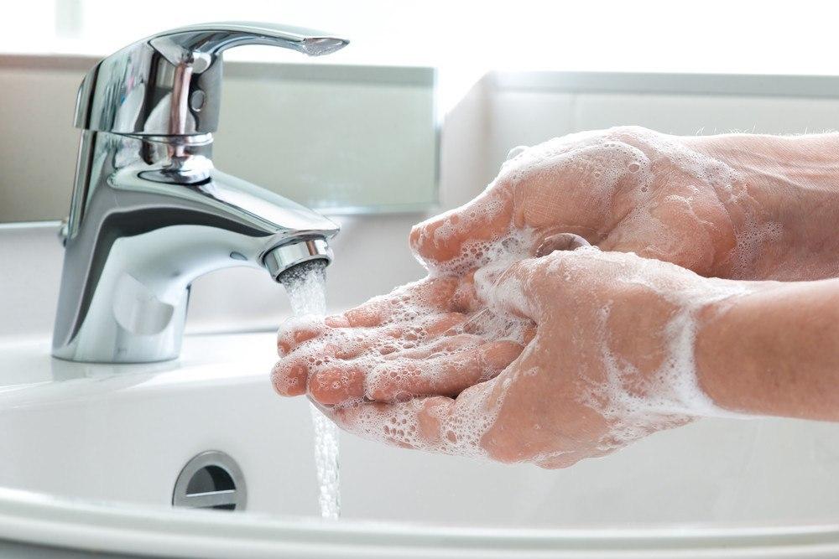
Aziz o‘quvchilar,
Shaxsiy gigiyena qoidalariga amal qiling
va qo‘lingizni tez-tez sovunlab yuvishni unutmang!

Slide 18
Harakat turlari
Tekis harakat
$S_{1}$=5 m
$$θ$$
$S_{2}$=5 m
$S_{3}$=5 m
$t_{1}$=1 s
$t_{2}$=1 s
$t_{3}$=1 s
$S_{1}$=5 m
Notekis harakat
$$θ$$
$S_{2}$=10 m
$S_{3}$=15 m
$t_{1}$=1 s
$t_{2}$=1 s
$t_{3}$=1 s

