Slide 1


ALGEBRA
7-sinf
Mavzu: Ko‘phadlar

Slide 2
Ko‘phadlar
1) 5аb² + 7 2) 1,5а ∙ 0,6b 3) 3a2аb² – b
4) 3b + 5с 5) 7ху 6) 6,7 – к+ 3n
Bir nechta birhadning algebraik yig‘indisi ko‘phad deyiladi.
Ko‘phadni tashkil qiluvchi birhadlar shu ko‘phadning hadlari deyiladi.
1) 5аb² + 7
3) 3a2аb ² – b
4) 3b + 5с
6) 6,7– к+3n
15mn² – 0,7m²k + nk³ - 4n⁷
- to‘rthad.

Slide 3
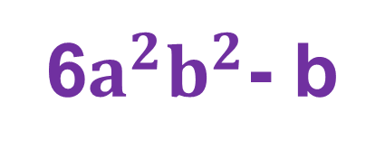
Ko‘phadlarni standart shaklga keltirish:
1.
3a2аb² – b =
6$a^{2}b^{2}$- b
2.
24x³ yx - 3xy =
24x⁴ y - 3xy
3.
0,2а²5а²b³ + 2аb³ – bаb =
а⁴b³ + 2аb³ - аb²

Slide 4

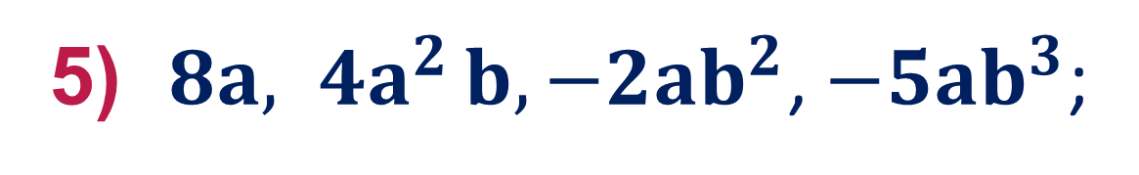
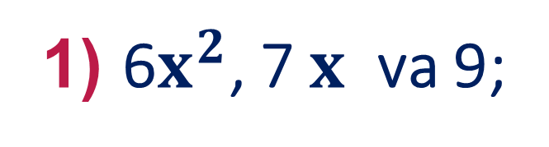
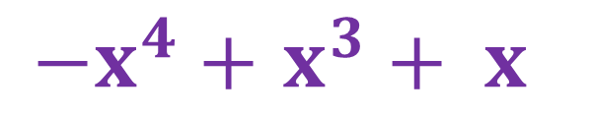
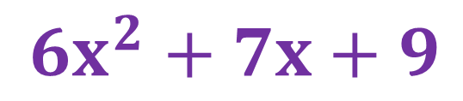

249- misol
Birhadlardan ko‘phad tuzing:
1) 6$x^{2}$, 7 $x$ va 9;
${6x}^{2}+7x+9$
3) $−x^{4}$, $x^{3} va x;$
$−x^{4}+$ $x^{3}+ x$
5) $8a{, 4a}^{2}b, −2ab^{2}$, ${−5ab}^{3}$;
$$8a{+4a}^{2}b+\left(−2ab^{2}\right)+{(−5ab}^{3})=$$
$$=8a{+4a}^{2}b−2ab^{2}{−5ab}^{3}$$

Slide 5
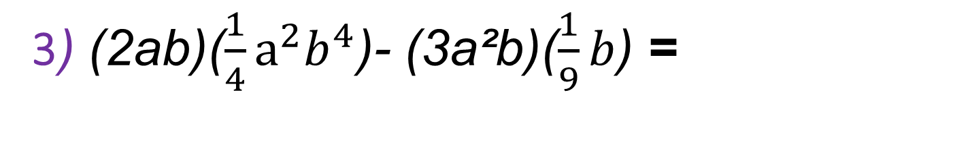
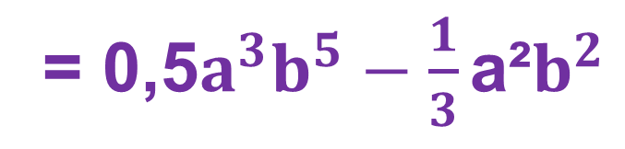
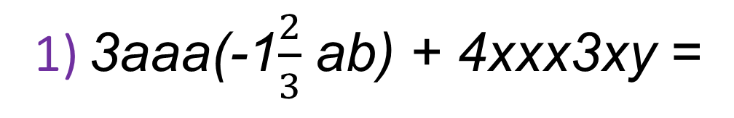
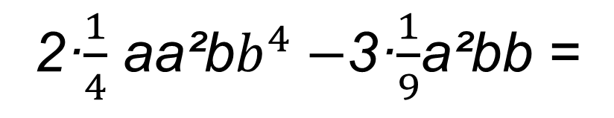

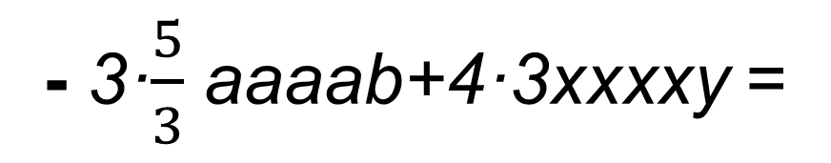
251- misol
Ifodani, uning har bir qo‘shiluvchisini standart shaklga
keltirib, soddalashtiring :
1) 3aaa(-1$\frac{2}{3}$ ab) + 4xxx3xy =
- 3·$\frac{5}{3}$ aaaab+4·3xxxxy =
= - 5$a^{4}b+12x^{4}y$
3) (2ab)($\frac{1}{4}a^{2}b^{4}$)- (3a²b)($\frac{1}{9}b$) =
2·$\frac{1}{4}$ aa²b$b^{4}−$3·$\frac{1}{9}$a²bb =
= 0,5$a^{3}b^{5}−{\frac{1}{3}\text{a}\text{²}b}^{2}$

Slide 6
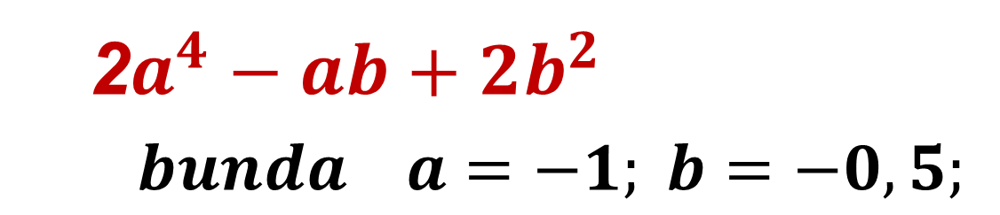
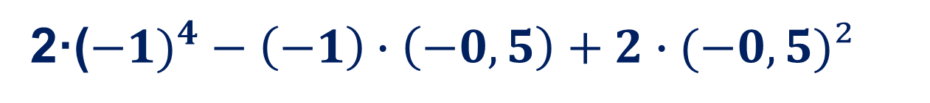
252- misol
Ko‘phadning son qiymatini toping:
2
2$a^{4}−ab+2b^{2}$
$bunda a=−1; b=−0,5;$
2·(${−1)}^{4}−\left(−1\right)∙\left(−0,5\right)+2∙(−0,5)²$
= 2 – 0,5 + 0,5 = 2

Slide 7
Mustaqil bajarish uchun topshiriqlar:
Darslikning 77-betida berilgan
250- 253- misollarni
yechish.

