Slide 1

ALGEBRA
7-sinf
Mavzu: Birhadlarni ko‘paytirish mavzusida misollar yechish

Slide 2

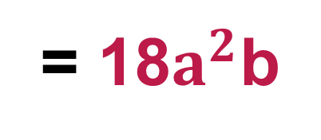


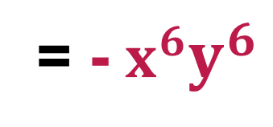
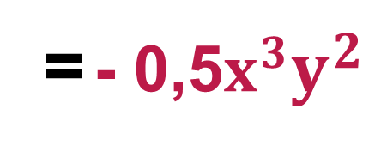
Ko‘paytirishni bajaring:
= ($\frac{2}{3}$∙12)∙(a∙аb)
а) 2/3а∙12аb
b) 0,5х²у∙(-ху)
c) -0,4х⁴у²∙2,5х²у⁴
= 18$a^{2}$b
= 0,5∙(х²∙(-х)∙y∙y)
= - 0,5$x^{3}y^{2}$
= (- 0,4∙2,5)·(х⁴∙ х²∙y²∙ y⁴)
= - $x^{6}y^{6}$
d) -0,5х³у⁴∙1,4х⁶у⁴
= (- 0,5∙1,4)·(х³∙ х⁶∙y⁴∙ y⁴)
= - 0,7 $x^{9}y^{8}$

Slide 3

Nuqtalar o‘rnini to‘ldiring:
1.
2.
3.

Slide 4

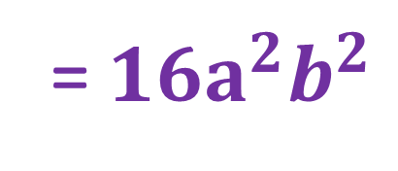
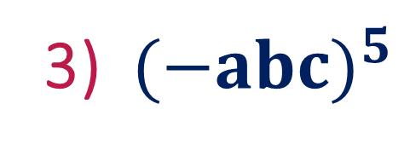
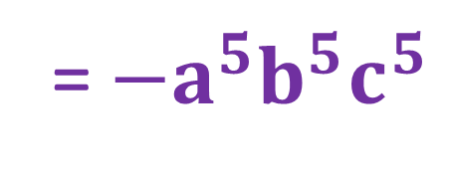
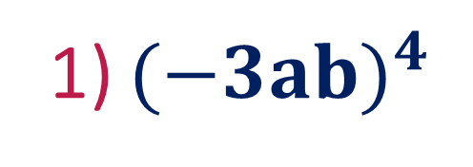
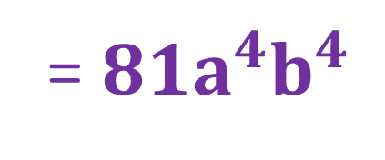
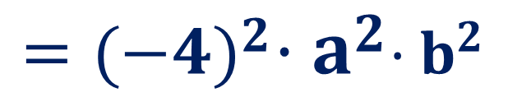
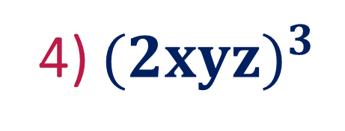
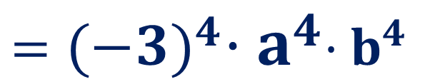
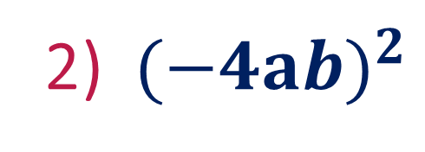
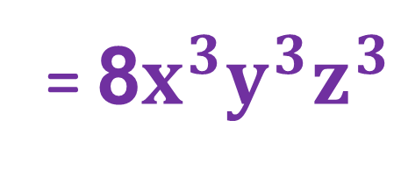
239- misol
Birhadlarni ko‘paytiring:
1) ${(−3ab)}^{4}$
$={{(−3)}^{4}{·a}^{4}·b}^{4}$
= ${81a}^{4}b^{4}$
2) $(−4ab)^{2}$
$${{=(−4)}^{2}{·a}^{2}·b}^{2}$$
= ${16a}^{2}b^{2}$
3) ${(−abc)}^{5}$
= ${−a}^{5}b^{5}c^{5}$
4) $(2xyz)^{3}$
= 8$x^{3}y^{3}z^{3}$

Slide 5

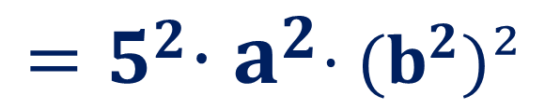
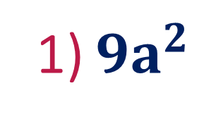
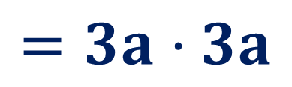
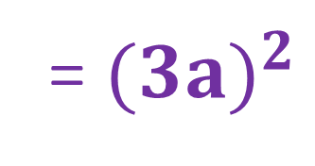

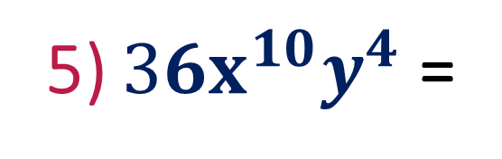

244- misol
Birhadni bo‘shqa birhadning kvadrati shaklida yozing:
1) ${9a}^{2}$
$$=3a·3a$$
= ${(3a)}^{2}$
3) $25a^{2}b^{4}$
$${{=5}^{2}{·a}^{2}·(b}^{2})²$$
= (5ab²)²
( )²
5) $36x^{10}y^{4}$ =
6
$$x^{5}$$
$$y^{2}$$

Slide 6
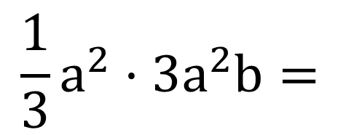
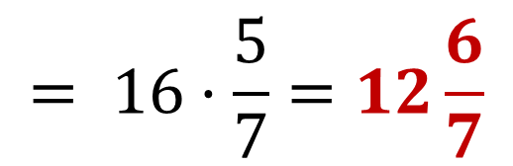
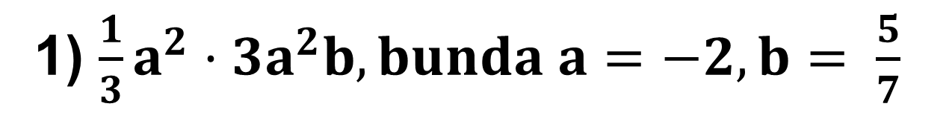
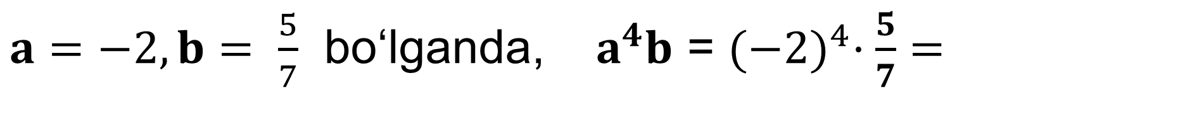
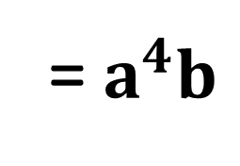
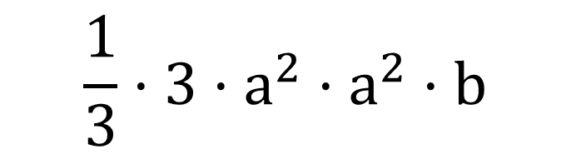
245- misol
Birhadlarni ko‘paytiring va hosil bo‘lgan ifodaning
qiymatini toping:
1) $\frac{1}{3}a^{2}·3a^{2}b, bunda a=−2, b= \frac{5}{7}$
$$\frac{1}{3}a^{2}·3a^{2}b=$$
$$\frac{1}{3}·3·a^{2}·a^{2}·b$$
= $a^{4}b$
$a=−2, b= \frac{5}{7}$ bo‘lganda, $a^{4}b$ = ${(−2)}^{4}·\frac{5}{7}=$
$$= 16·\frac{5}{7}=12\frac{6}{7}$$

Slide 7
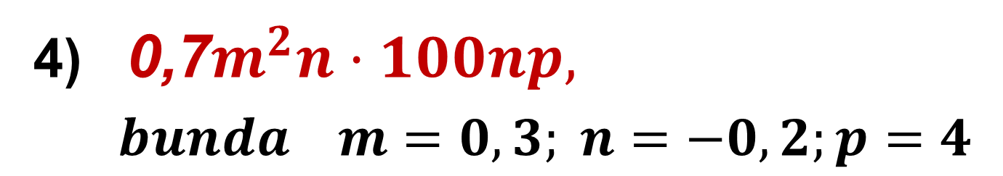
245- misol
Birhadlarni ko‘paytiring va hosil bo‘lgan ifodaning
qiymatini toping:
4) 0,7$m^{2}n·100np,$
$bunda m=0,3; n=−0,2;p=4$
1,008

Slide 8

Mustaqil bajarish uchun topshiriqlar:
Darslikda berilgan
238-, 240-, 243-, 245 - misollarni
yechish (74-bet).

