Slide 1

ALGEBRA
7-sinf
Mavzu: Birhadlarni ko‘paytirish

Slide 2

Xatolikni aniqlang!
1) 5∙5∙5∙5 = 5⁴
2) (-3)²=-3∙3=-9
3) 7¹= 1
4) (х²)³(х⁴)²=(х⁶)⁵=х³⁰
5) 2³2⁷=2¹⁰
6) 2³2⁷ = 2¹⁰
7) 2³+2⁷=2¹⁰
8) 2³⁰:2¹⁰=2³
9) (2х)³= 8х³
10) (х³)²=х⁹
9
136
7
2²⁰
х¹⁴
х⁶

Slide 3
Birhadlarni ajrating?
-1,7ху²
-с
15/х⁵
х²у-3у
х+у
2(х+у)²
х²х
0
х²⁰
0,7

Slide 4
Birhadning koeffitsiyenti va darajasini aniqlang
хс⁴у⁵
k=1
n=10
k=67
n=0
67
-4ху
k=-4
n=2
-8х⁷
k=-8
n=7
5х⁹0,5у²
k=2,5
n=11
у
k=1
n=1

Slide 5
Mustahkamlash
Birhadni standart shaklga keltiring:
3x²b³y8xb⁴
Yechim:
3x²b³y8xb⁴=(3∙8)∙(x²x)∙(b³b⁴)∙y=24x³b⁷y
(3x²b³y)∙(8xb⁴)
= (3∙8)∙(x²x)∙(b³b⁴)∙y = 24x³b⁷y

Slide 6

Birhadni ikkita birhad ko‘paytmasi ko‘rinishida ifodalang:
6a²b³
6a²b³ = 3ab∙2ab² = 6ab²∙ab = 2b³∙3a²
2b³∙3a²
= 6a²b³
3ab∙2ab²
= 6a²b³
6ab²∙ab
= 6a²b³

Slide 7
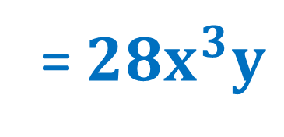
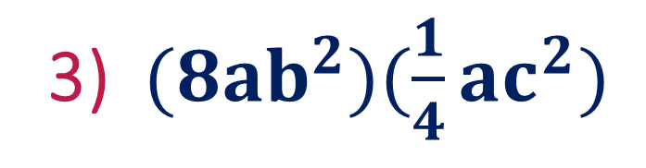
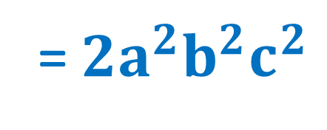
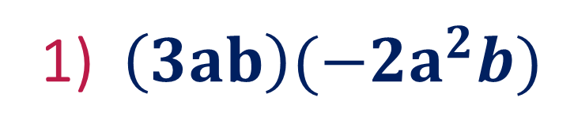
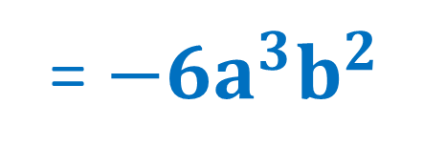
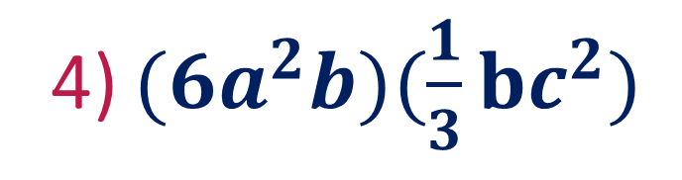
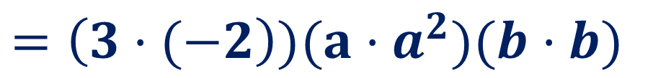
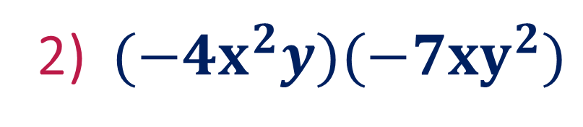
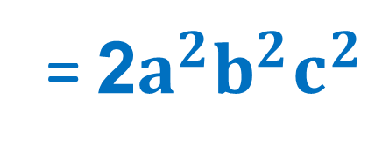
233- misol
Birhadlarni ko‘paytiring:
1) ${\left(3ab\right)(−2a}^{2}b)$
$={\left(3·(−2\right))(a·a}^{2})(b·b)$
= ${−6a}^{3}b^{2}$
2) $({−4x}^{2}y)(−7xy^{2})$
= ${28x}^{3}y$
3) ${(8ab}^{2})(\frac{1}{4}ac^{2})$
= $2a^{2}b^{2}c^{2}$
4) ${(6a}^{2}b)(\frac{1}{3}bc^{2})$
= 2$a^{2}b^{2}c^{2}$

Slide 8

Mustaqil bajarish uchun topshiriqlar:
Darslikning 73 – betida berilgan
230 - 232, 235 - 237 - misollarni
yechish.

