Slide 1

ALGEBRA
7-
sinf
MAVZU: TENGLAMALAR YECHISH

Slide 2
Tenglamani yechish uchun:
noma’lum qatnashgan hadlarni tenglikning chap qismiga, noma’lum qatnashmagan hadlarni esa o‘ng qismiga o‘tkazish lozim;
o‘xshash hadlarni ixchamlash kerak;
tenglamaning ikkala qismini noma’lum oldida turgan koeffitsiyentga bo‘lish kerak.

Slide 3
№94. Tenglamani yeching
0,71x + 1,98 = 0,37x – 1,76
0,34x = 3,74
x = 3,74 : 0,34
x = 11
–
1,98
–
0,37x
0,71x = – 1,76
0,34
3,74
–
34
1
1
34
–
34
0

Slide 4
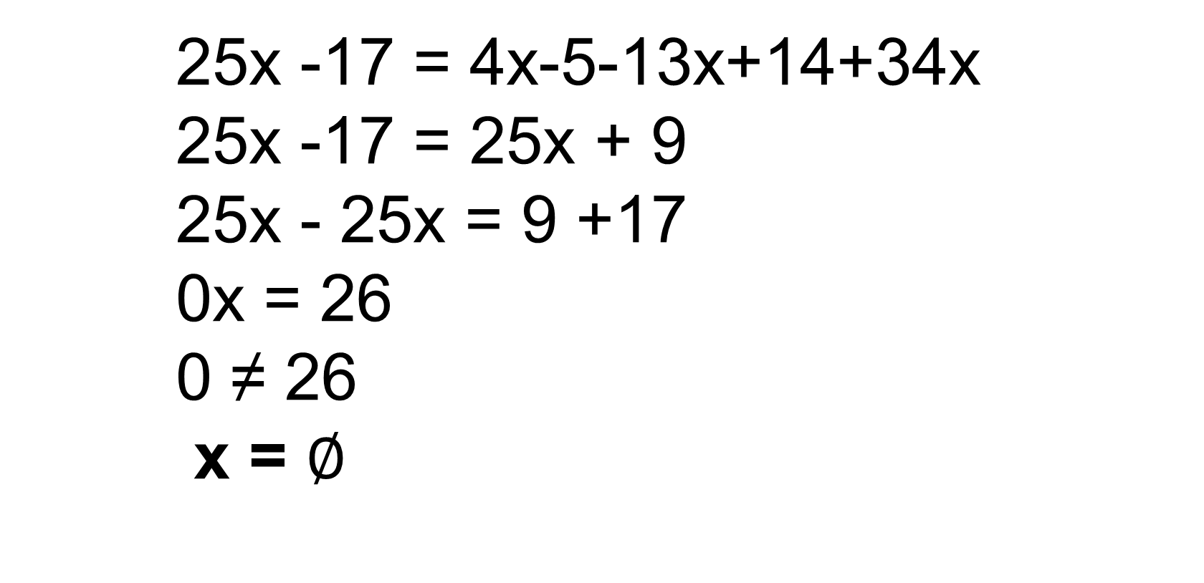
№97(2). Tenglamaning ildizga ega
emasligini ko‘rsating
25x -17 = 4x-5-13x+14+34x
25x -17 = 25x + 9
25x - 25x = 9 +17
0x = 26
0 ≠ 26
x = $∅$
Javob: Tenglama ildiziga ega emas.

Slide 5
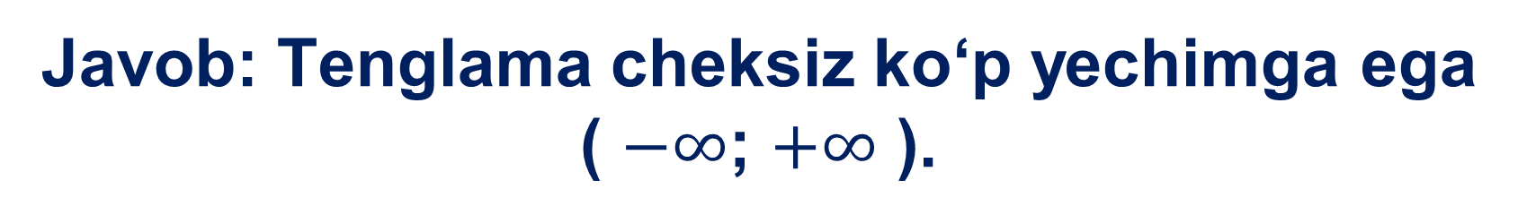

№98(4). X ning istalgan qiymati tenglamaning ildizi bo‘la olishini isbotlang:
8(1,5x+0,25)$−$8,6x = 3,4x+2
12x+2$−$8,6x = 3,4x+2
12x$−$8,6x$−$3,4x = 2$−$2
0∙x = 0
Javob: Tenglama cheksiz ko‘p yechimga ega
( $−∞$; $+∞$ ).

Slide 6
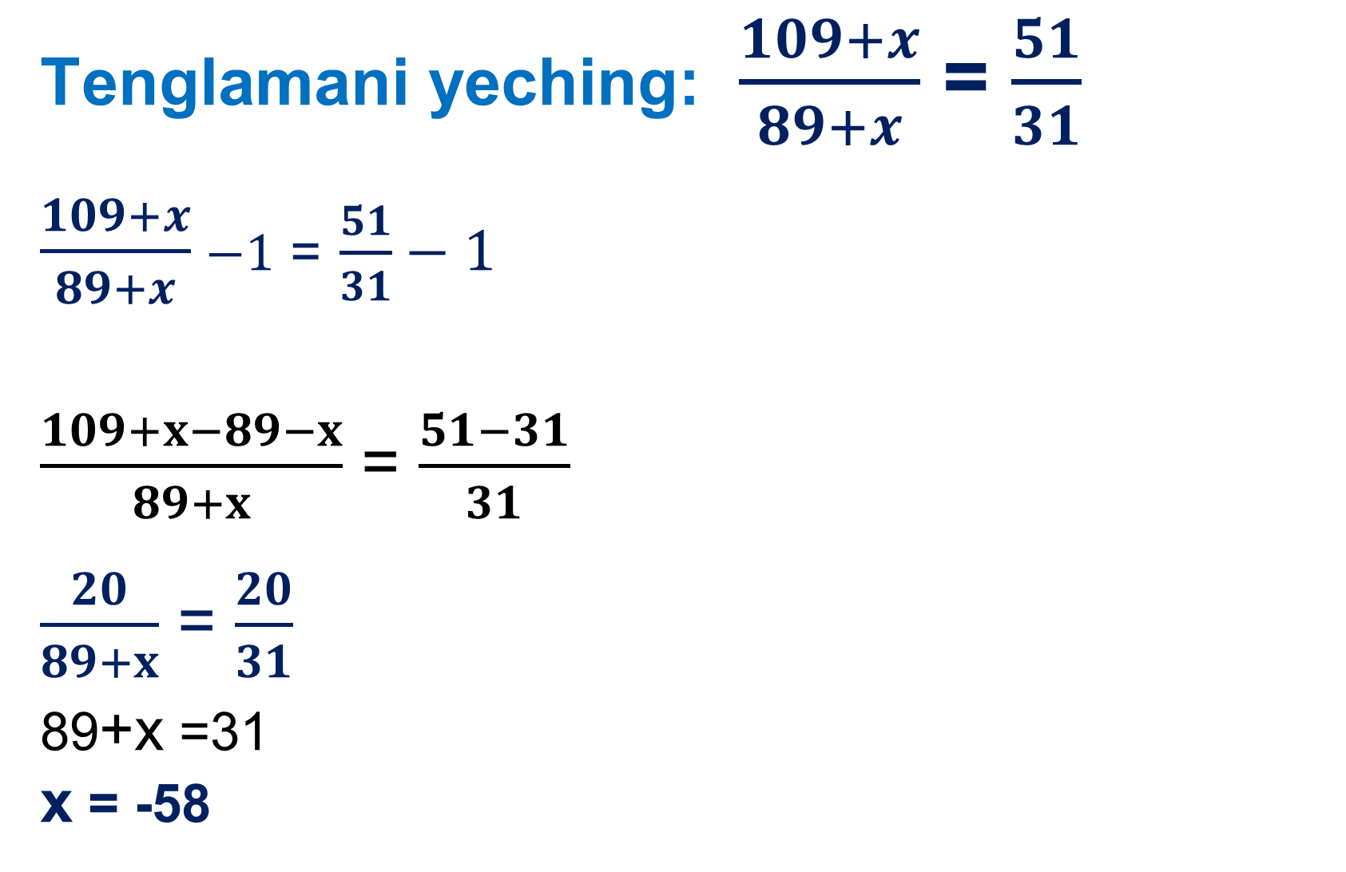
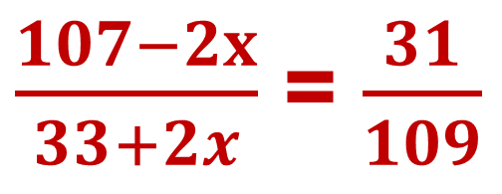
Tenglamani yeching: $\frac{109+x}{89+x}$ = $\frac{51}{31}$
$\frac{109+x}{89+x}$ $−1$ = $\frac{51}{31}−1$
$\frac{109+x−89−x}{89+x}$ = $\frac{51−31}{31}$
$\frac{20}{89+x}$ = $\frac{20}{31}$
89+x =31
x = -58
$\frac{107−2x}{33+2x}$ = $\frac{31}{109}$

Slide 7
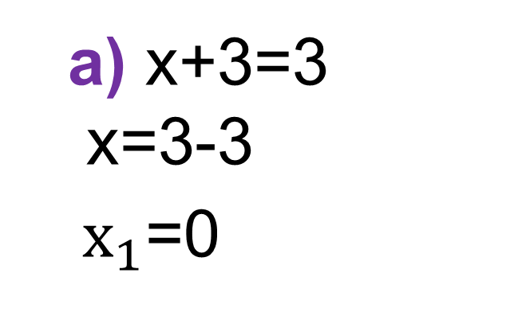
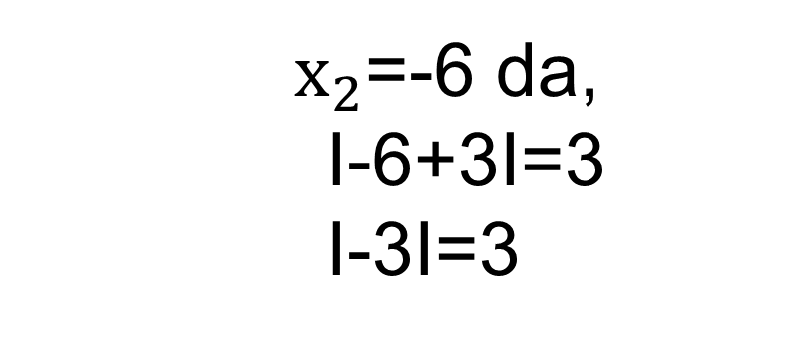
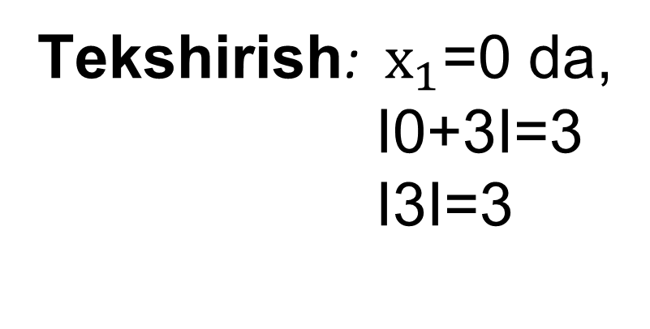

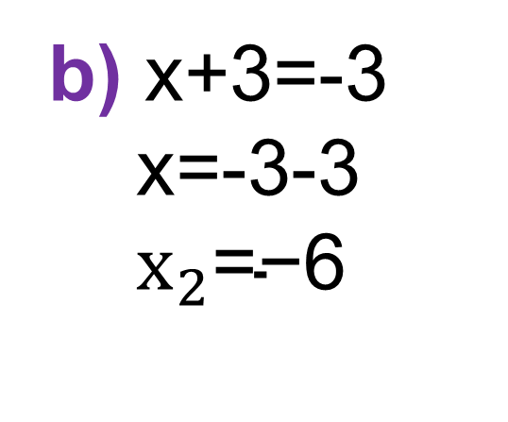
-a
0
a
∙
∙
∙
a birlik
a birlik
Modul qatnashgan tenglamani yeching: Ix+3I=3
a) x+3=3
x=3-3
$x_{1}$=0
b) x+3=-3
x=-3-3
$x_{2}\text{=−6}$
Javob:
$x_{1}$=0; $x_{2}\text{=−6}$
Tekshirish: $x_{1}$=0 da,
I0+3I=3
I3I=3
$x_{2}$=-6 da,
I-6+3I=3
I-3I=3

Slide 8
Mustaqil bajarish uchun topshiriqlar:
Darslikda berilgan
94-,97-,100 - topshiriqlarni
bajarish (42-bet).

