Slide 1

ALGEBRA
7-
sinf
MAVZU: Arifmetik amallarning xossalari
O‘qituvchi: Yusupjonova Shahnoza Mirzatillayevna

Slide 2
Arifmetik amallarning xossalari
Arifmetik amallarning xossalarini o‘z tilimizda qonunlar deb ataymiz. Bu qonunlar yordamida boshqa xossalarni yaratish mumkin.
O‘rin almashtirish qonuni;
Gurulanish qonuni;
Taqsimot qonuni.

Slide 3
Arifmetik amallarning xossalari
1. O‘rin almashtirish qonuni
-5+14 = 14-5 = 9
a+b = b+a
9,2+48+0,8 = 9,2+0,8+48 = 58
ab = ba
1,25 ∙(-8) = -8 ∙1,25 = -10
45a∙2 = 45∙2∙a = 90a

Slide 4
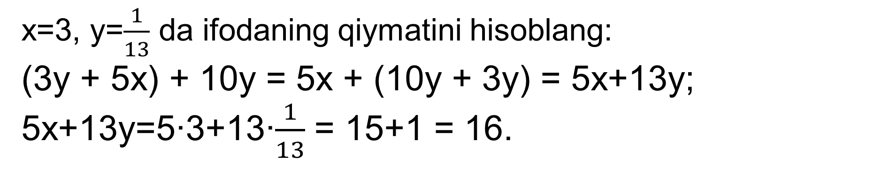
Arifmetik amallarning xossalari
2. Guruhlash qonuni
(a + b)+c = a + (b + c) = b + (a + c)
x=3, y=$\frac{1}{13}$ da ifodaning qiymatini hisoblang:
(3y + 5x) + 10y = 5x + (10y + 3y) = 5x+13y;
5x+13y=5∙3+13∙$\frac{1}{13}$ = 15+1 = 16.
(ab)c = a(bc) = b(ac)
50 ∙ (47 ∙ 2) = 47 ∙ (50 ∙ 2) = 4700

Slide 5
Arifmetik amallarning xossalari
3. Taqsimot qonuni
a(b+c) = ab + ac
ab + ac = a(b + c)
a(b-c) = ab - ac
ab - ac = a(b - c)
1) (0,1a +0,4) ∙ 25 = 0,1a∙25 + 0,4∙25 = 2,5a + 10
2) 3a∙3,75 + 3a∙1,25= 3a∙(3,75 + 1,25)= 3a∙5=15a

Slide 6
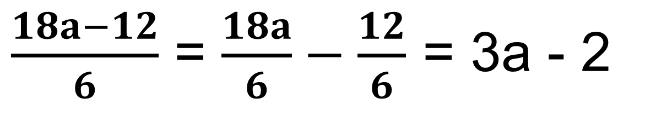
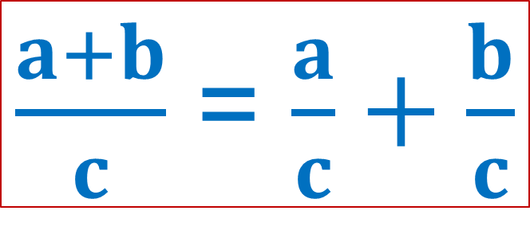
Formulalar
(a+b) : c = a : c + b : c
$\frac{a+b}{c}$ = $\frac{a}{c}+\frac{b}{c}$
(16 + 5,6): 8 = 16:8 + 5,6:8 = 2+0,7 = 2,7
$\frac{18a−12}{6}$ = $\frac{18a}{6}−\frac{12}{6}$ = 3a - 2

Slide 7
49(1) - misol
Sonli ifodaning qiymatini toping:
29∙0,45 + 0,45∙11;
ab + ac = a(b + c)
29∙0,45 + 0,45∙11= 0,45∙(29 + 11)=
= 0,45∙40 = 18

Slide 8
49(4) - misol
Sonli ifodaning qiymatini toping:
-11,401 - 23,17 + 4,401 - 10,83 = ?
a+b+c+d = (a+c)+(b+d)
-11,401 - 23,17 + 4,401 - 10,83 =
= (-11,401 + 4,401) - (23,17+10,83)=
= -7 - 34 = - 41

Slide 9
Formulalar
(a + b + c)d = ad + bd + cd
( abc )d = ( ab ) ( cd )
(1,3 + 0,3 + 8,4)∙10 =
=1,3∙10 + 0,3∙10 + 8,4∙10 =
=13 + 3 + 84 = 100.

Slide 10
Ayirishni qo‘shish orqali ifodalash
a sondan b sonni ayirish uchun a songa
b songa qarama-qarshi bo‘lgan sonni
qo‘shish kifoya:
a – b = a + (-b)
1) - 3,7 – 7,3 = -3,7 + (-7,3) = -11
2) 25p - 125p = 25p + (-125p) = -100p

Slide 11
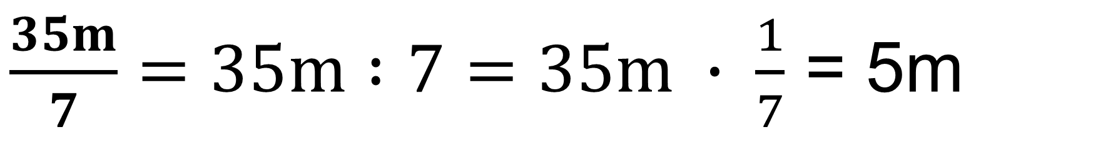

Arifmetik amallarning xossalari
a sonni b songa bo‘lish uchun a
sonni b songa teskari bo‘lgan songa
ko‘paytirish kerak.
$$\frac{a}{b}=a :b=a ∙ \frac{1}{b}$$
$\frac{35m}{7}=35m :7=35m ∙ \frac{1}{7}$ = 5m

Slide 12
№50.O‘xshash hadlarni ixchamlang:
2) x - 2y - 3x + 5y = x - 3x - 2y + 5y=
= -2x +3y
3) 0,1c - 0,3 + d - c - 2,1d =
= 0,1c - c + d - 2,1d + 0,3 =
= - 0,9c - 1,1d + 0,3

Slide 13
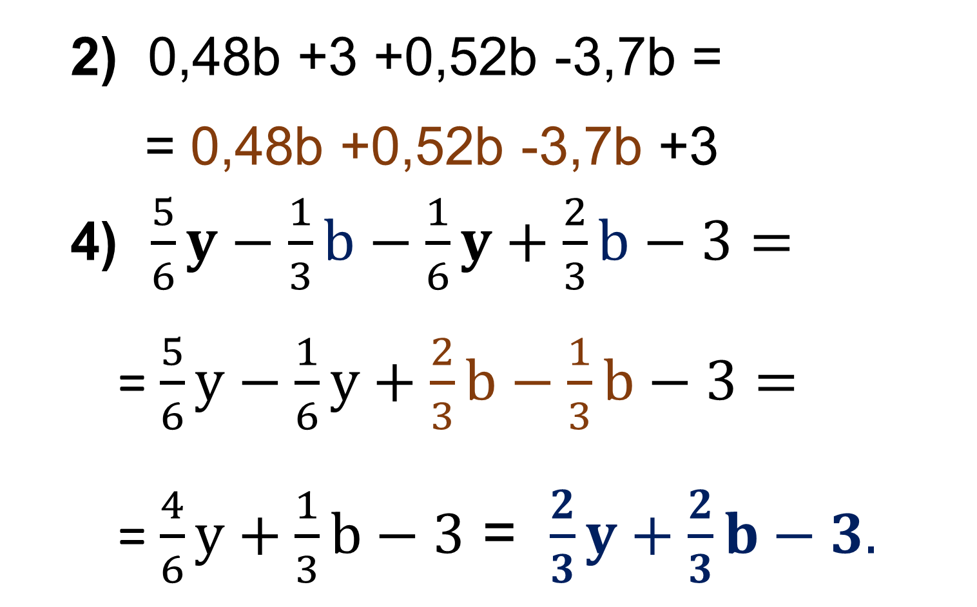
№51.O‘xshash hadlarni ixchamlang:
2) 0,48b +3 +0,52b -3,7b =
= 0,48b +0,52b -3,7b +3
4) $\frac{5}{6}y−\frac{1}{3}b−\frac{1}{6}y+\frac{2}{3}b−3=$
= $\frac{5}{6}y−\frac{1}{6}y+\frac{2}{3}b−\frac{1}{3}b−3=$
= $\frac{4}{6}y+\frac{1}{3}b−3$ = $\frac{2}{3}y+\frac{2}{3}b−3.$
= 3 - 2,7b

Slide 14
Ifodani soddalashtiring:
№52(2)
4(2 + x) -3(1 + x) =
= 8 + 4x - 3 - 3x =
= 4x - 3x + 8 – 3 =
= x+5
№52(4)
11(5c+d)+3(d + c) =
= 55c+ 11d + 3d+ 3c =
= 58c+14d

Slide 15
№53. Ifodani soddalashtiring va x=-10da
son qiymatini toping:
4) 0,01( 2,2x - 0,1) +0,1(x - 100) =
= 0,022x - 0,001 + 0,1x - 10 =
= 0,022x + 0,1x - 0,001 - 10 =
= 0,122x -10,001; x = -10da,
-0,122∙10 - 10,001 = -11,221

Slide 16
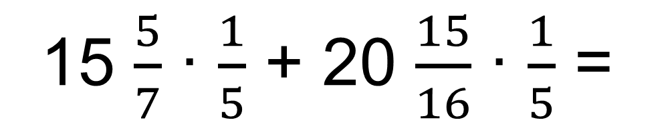
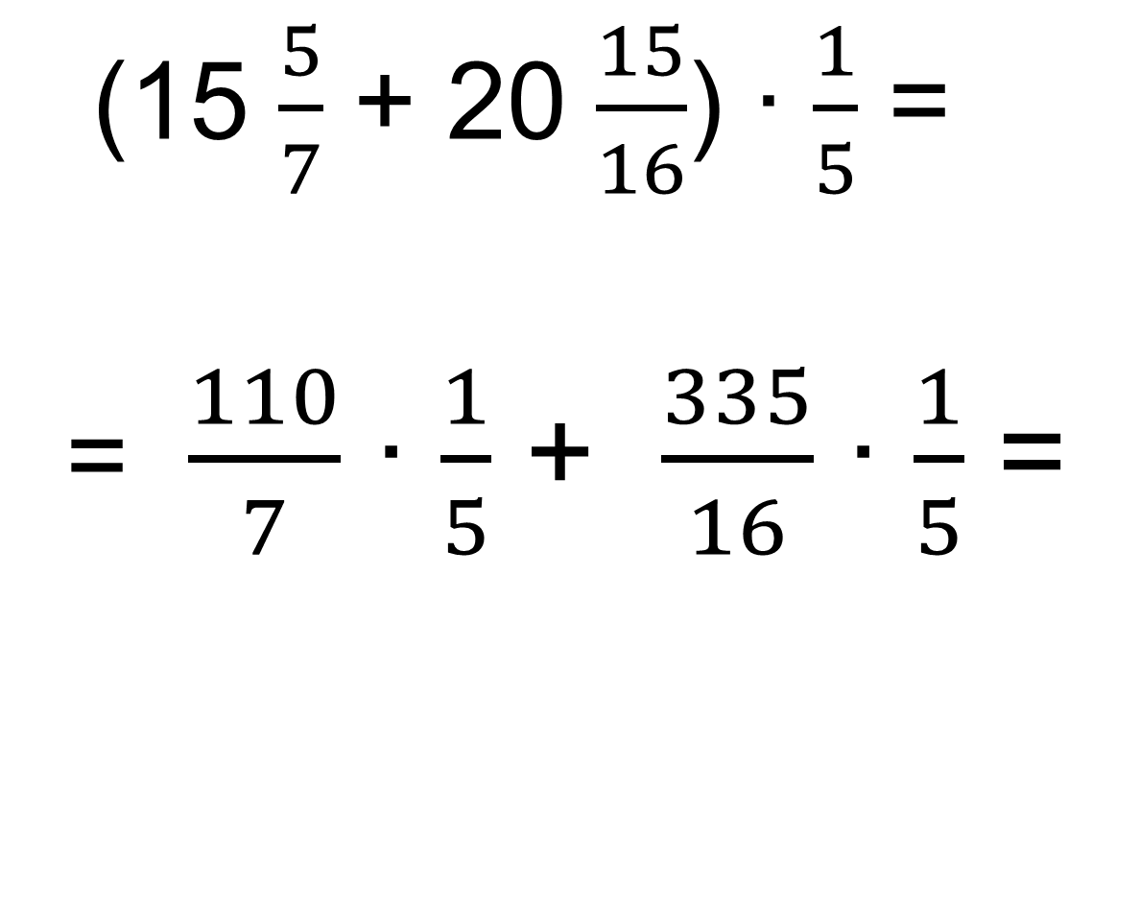
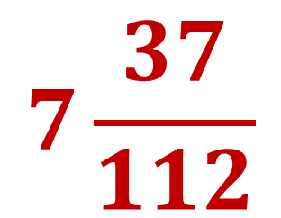
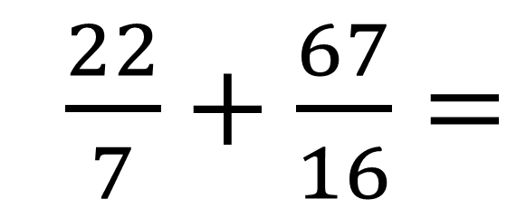
№54(4). Arifmetik amallarning xossalaridan
foydalanib hisoblang:
;
(15 $\frac{5}{7}$ + 20 $\frac{15}{16}$) ∙ $\frac{1}{5}$ =
= $\frac{110}{7}$ ∙ $\frac{1}{5}$ + $\frac{335}{16}$ ∙ $\frac{1}{5}$ =
15 $\frac{5}{7}$ ∙ $\frac{1}{5}$ + 20 $\frac{15}{16}$ ∙ $\frac{1}{5}$ =
$\frac{22}{7}+\frac{67}{16}=$
$$7\frac{37}{112}$$

Slide 17
Mustaqil bajarish uchun topshiriqlar:
Darslikdagi
49(2,3),- 50(1,4),- 51- misollarni yechish(24 - bet).

Slide 18

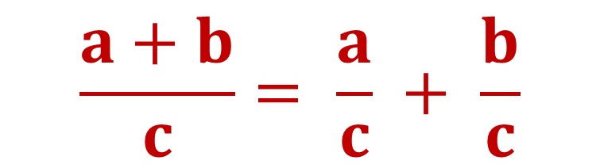

Tenglikni isbotlang:
$$\frac{a+b}{c}= \frac{a}{c} + \frac{b}{c}$$
$\frac{a+b}{c} =(a+b)∙ \frac{1}{c}$
$\frac{a+b}{c}=a∙ \frac{1}{c}$ + $b ∙ \frac{1}{c}$
$$\frac{a+b}{c}=\frac{a}{c} + \frac{b}{c}$$
$$⇒$$
Tenglik isbotlandi.

