Slide 1

ALGEBRA
7-
sinf
MAVZU: Takrorlashga doir misollar yechish
O‘qituvchi: Yusupjonova Shahnoza
Mirzatillayevna

Slide 2
MUSBAT VA MANFIY SONLAR USTIDA AMALLAR
-a
0
a
∙
∙
∙
manfiy sonlar
musbat sonlar
+ + = +
+ - = -
- - = +
- + = -
50 -(-92) =50+92 =142;
-10+(+4,2)= -10+4,2=-5,8;
-4,25 +(-10,75)= -4,25 -10,75= -15;
10∙(-4,2) = - 42;
-144 : 12= -12.

Slide 3
№ 16(1). Amallarni bajaring:
(-120):((-8)∙(-3)+12:(-3))-(-48):(-16)=
= -120 : (24 - 4) - 3 =
= -120 : 20 -3 =
= - 6 – 3 = -9

Slide 4
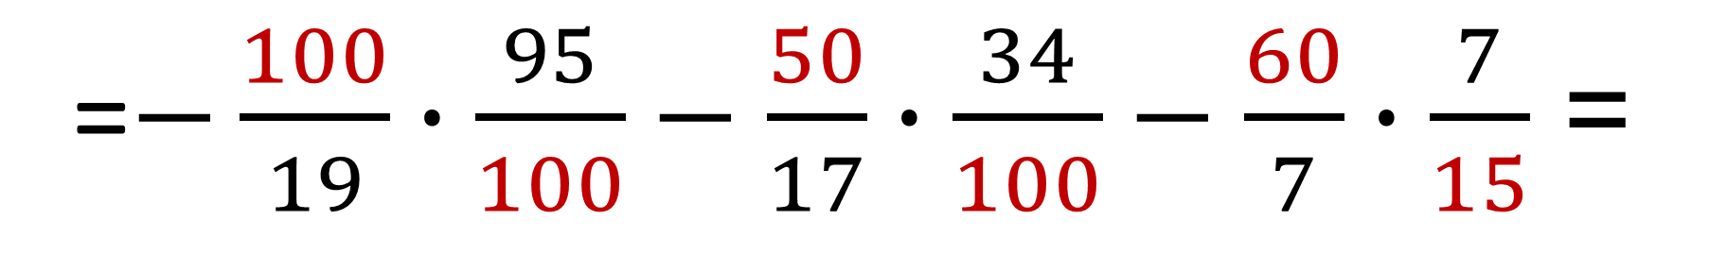
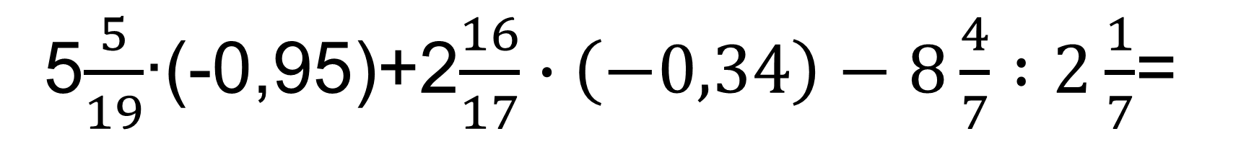
№ 16(4). Amallarni bajaring:
5$\frac{5}{19}$∙(-0,95)+2$\frac{16}{17}∙\left(−0,34\right)−8\frac{4}{7}∶2\frac{1}{7}$=
=$−\frac{100}{19}∙\frac{95}{100}−\frac{50}{17}∙\frac{34}{100}−\frac{60}{7}∙\frac{7}{15}$ =
= - 5 - 1 - 4 = -10

Slide 5
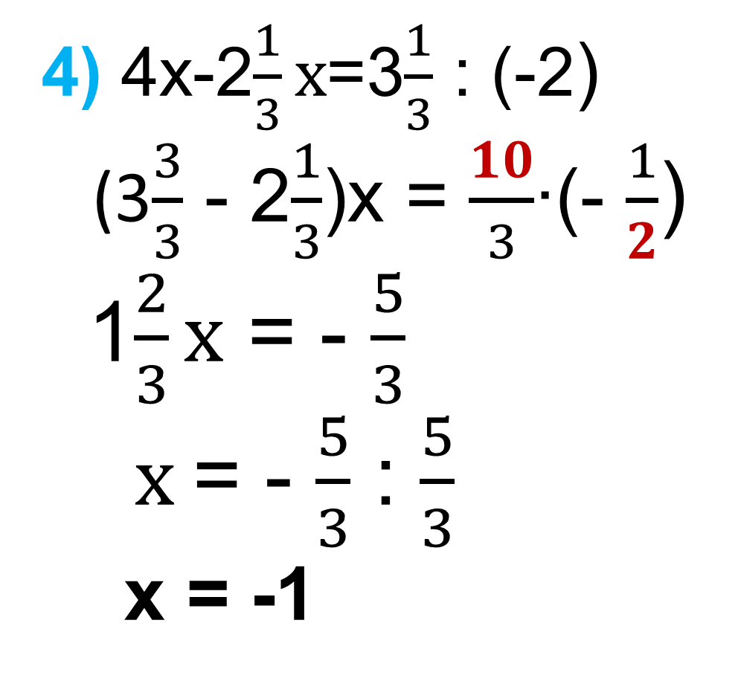
№17 Tenglamani yeching:
4) 4х-2$\frac{1}{3}x$=3$\frac{1}{3}$ : (-2)
(3$\frac{3}{3}$ - 2$\frac{1}{3}$)x = $\frac{10}{3}$∙(- $\frac{1}{2}$)
1$\frac{2}{3}x$ = - $\frac{5}{3}$
$x$= - $\frac{5}{3}$ : $\frac{5}{3}$
x = -1
1) 3x+2x=17+(-27)
5x = -10
x = - 10:5
x = -2
Javob:1)-2 va 4) -1

Slide 6
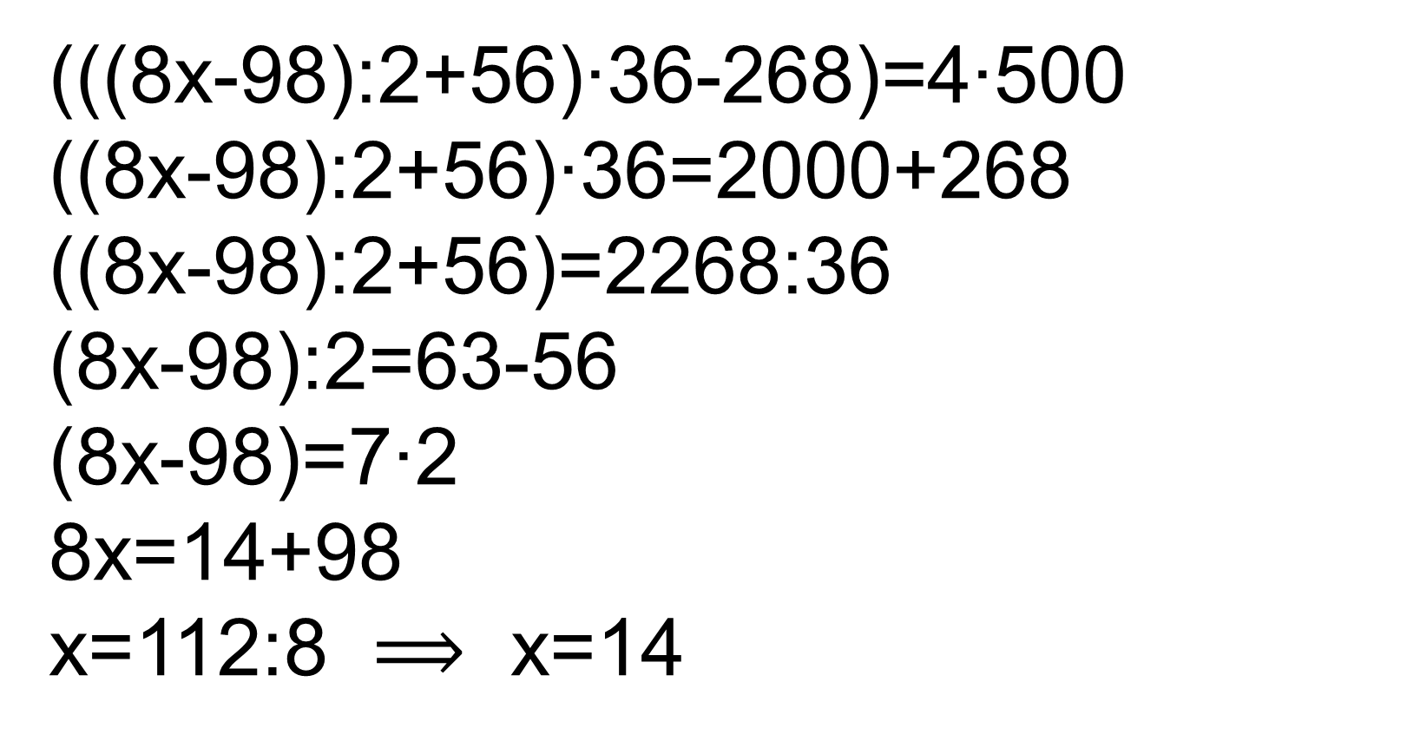
Tenglamani yechish:
(((8x-98):2+56)∙36-268):500=4
(((8x-98):2+56)∙36-268)=4∙500
((8x-98):2+56)∙36=2000+268
((8x-98):2+56)=2268:36
(8x-98):2=63-56
(8x-98)=7∙2
8x=14+98
x=112:8 $⟹$ x=14
Javob:14

Slide 7
MODUL TUSHUNCHASI
Berilgan a haqiqiy sonning moduli deb, sonlar o‘qining markazi yoki koordinatalar boshidan berilgan songacha bo‘lgan masofaga aytiladi
0
a
a, a ≥ 0
-a, a < 0
-a
IaI =
∙
∙
∙
a birlik
a birlik

Slide 8
MODUL TUSHUNCHASI
I-4I = 4
I4I = 4
0
4
-4
∙
∙
∙
4 birlik
4 birlik
Qarama qarshi sonlarning modullari o‘zaro teng.
! Modulning qiymati hech qachon manfiy son
bo‘lmaydi.

Slide 9
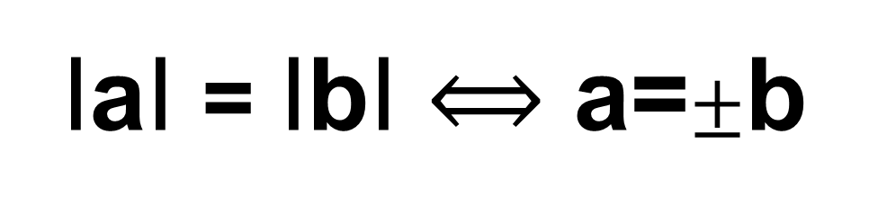
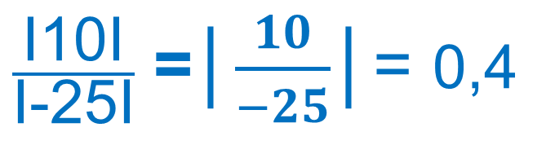
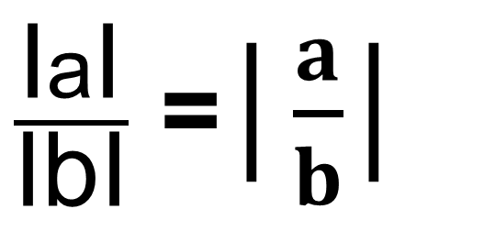
MODULNING XOSSALARI
I-aI = IaI
$\frac{\text{I}\text{a}\text{I}}{\text{I}\text{b}\text{I}}$ =│$\frac{a}{b}$│
IaI ≥ 0
I-8,5I = 8,5
I-8,5I ≠ -8,5
I-24I = I24I
24 = 24
$\frac{\text{I}\text{10}\text{I}}{\text{I}\text{−25}\text{I}}$ =│$\frac{10}{−25}$│= 0,4
IaI = IbI $⟺$ a=$±$b
Ia∙bI = IaI∙ IbI
I2020I = 2020
I-2020I = 2020
I-25∙4I = I-25I∙I4I

Slide 10
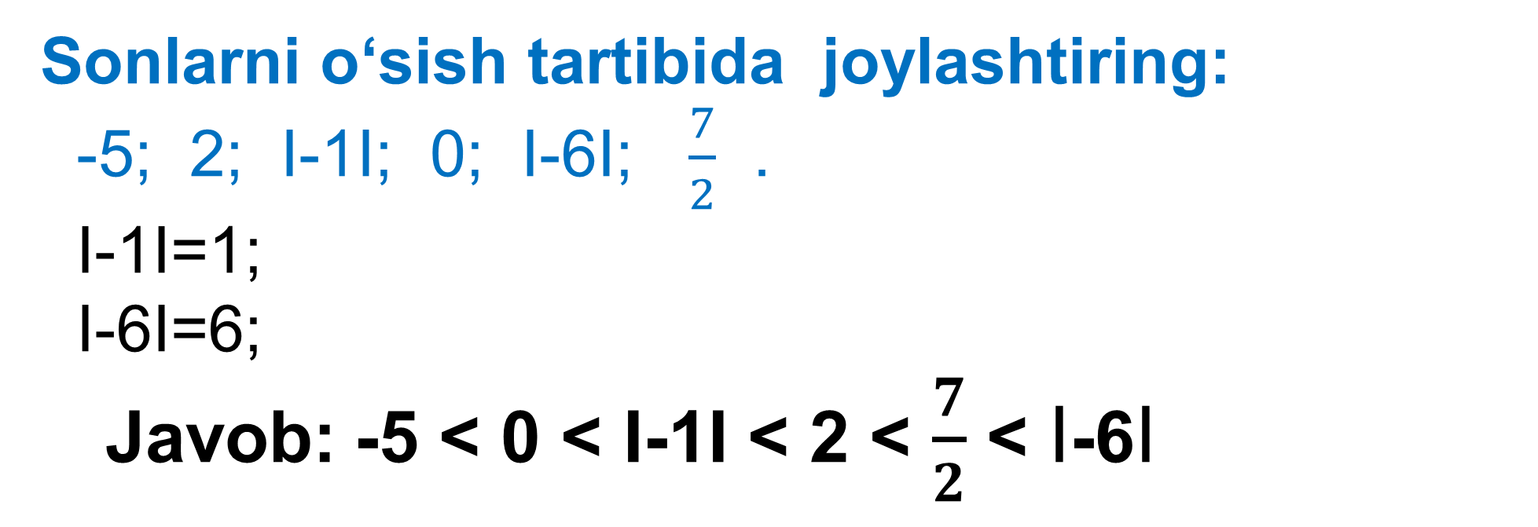
Hisoblang:
(I-8,5I + 1,5) : ( -82 - I-3∙6I) =
= ( 8,5 +1,5 ) : (-82 - 18) = 10 : (-100) = -0,1
Sonlarni o‘sish tartibida joylashtiring:
-5; 2; I-1I; 0; I-6I; $\frac{7}{2}$ .
I-1I=1;
I-6I=6;
Javob: -5 ˂ 0 ˂ I-1I ˂ 2 ˂ $\frac{7}{2}$ ˂ I-6I

Slide 11
Sonlarni kamayish tartibida joylashtiring:
-11; 0,65; I0,63I; -I+5,25I; -I-2,75I; I0I.
I0,63I = 0,63;
-I+5,25I = -5,25;
-I-2,75I = -2,75;
I0I = 0
0,65 > I0,63I > I0I > -I-2,75I > -I+5,25I > -11
0,65 > 0,63 > 0 > -2,75 > -5,25 > -11

Slide 12
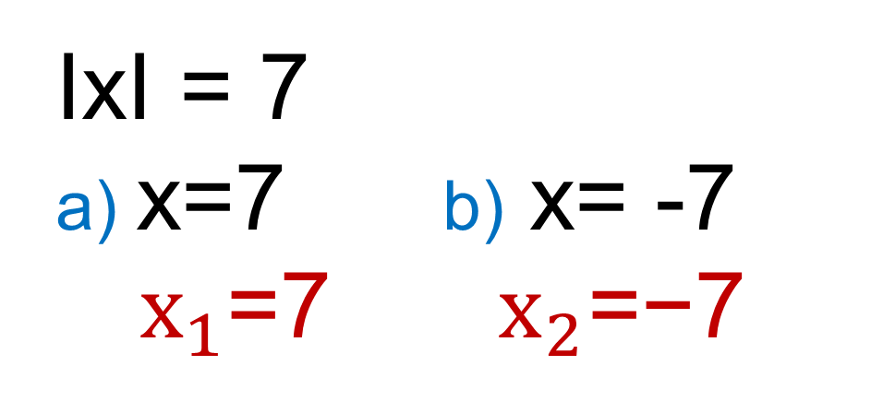
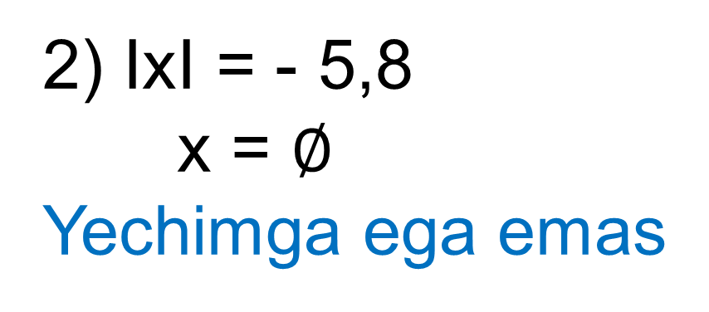
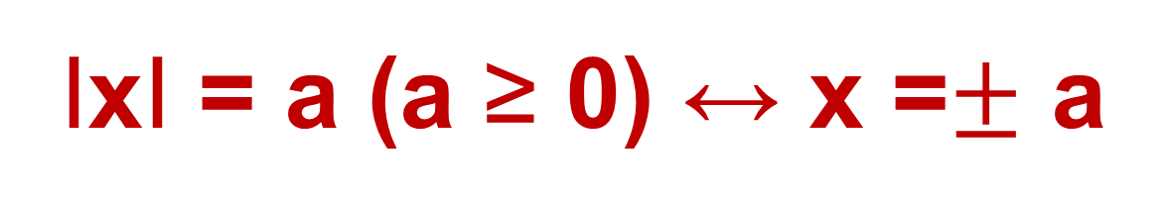
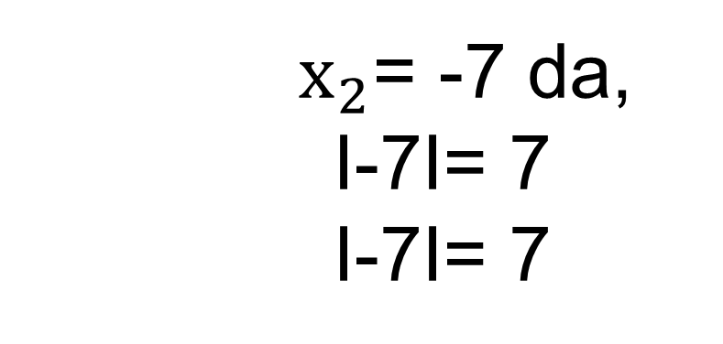
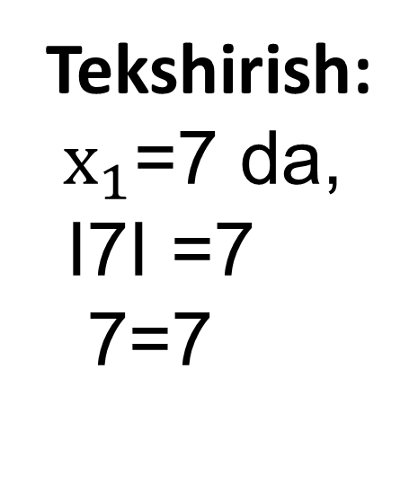
Modulli tenglama
IxI = a (a ≥ 0) ↔ x =$±$ a
1)
IxI = 7
a) x=7 b) x= -7
$x_{1}$=7 ${ x}_{2}\text{=−}\text{7}$
2) IxI = - 5,8
x = $∅$
Yechimga ega emas
Tekshirish:
$x_{1}$=7 da,
I7I =7
7=7
$x_{2}$= -7 da,
I-7I= 7
I-7I= 7

Slide 13
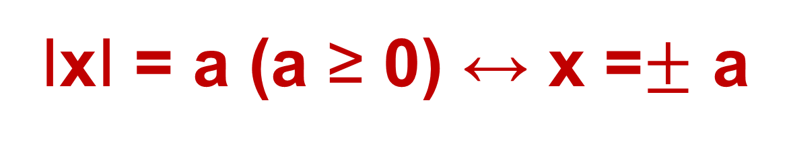
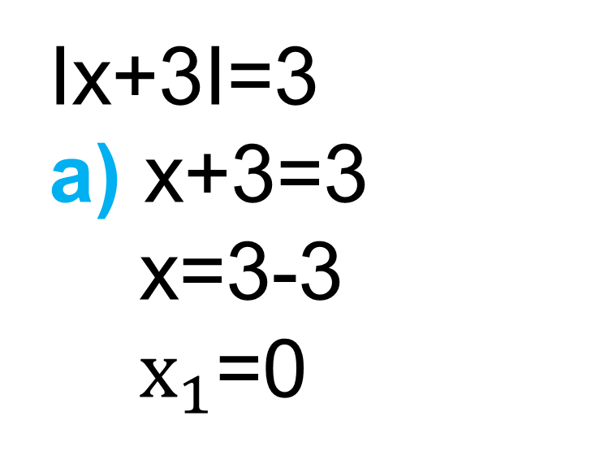
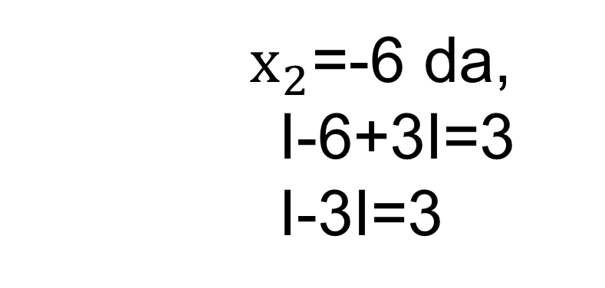
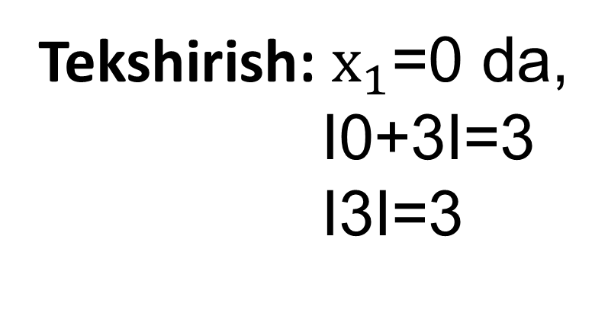
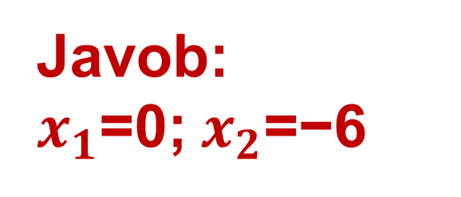
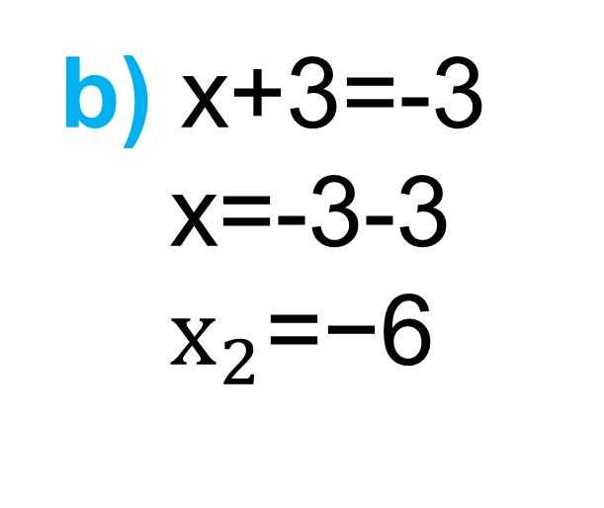
Modulli tenglama
IxI = a (a ≥ 0) ↔ x =$±$ a
Ix+3I=3
a) x+3=3
x=3-3
$x_{1}$=0
b) x+3=-3
x=-3-3
$x_{2}\text{=−6}$
Tekshirish: $x_{1}$=0 da,
I0+3I=3
I3I=3
$x_{2}$=-6 da,
I-6+3I=3
I-3I=3
Javob:
$x_{1}$=0; $x_{2}\text{=−6}$

Slide 14
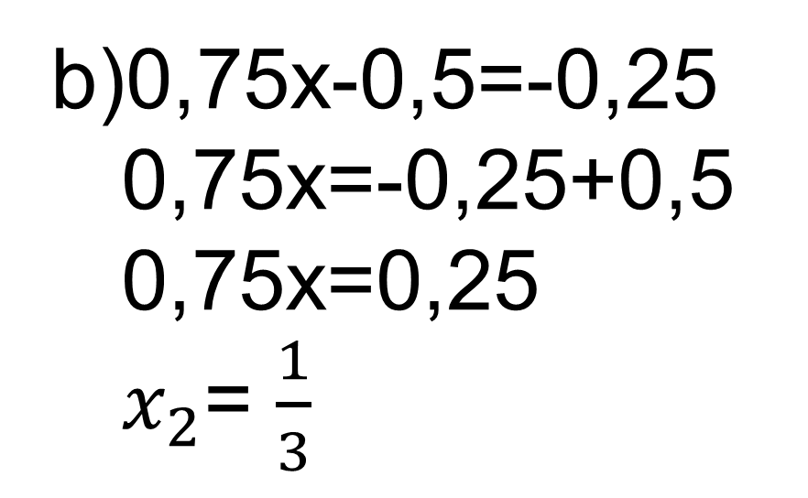
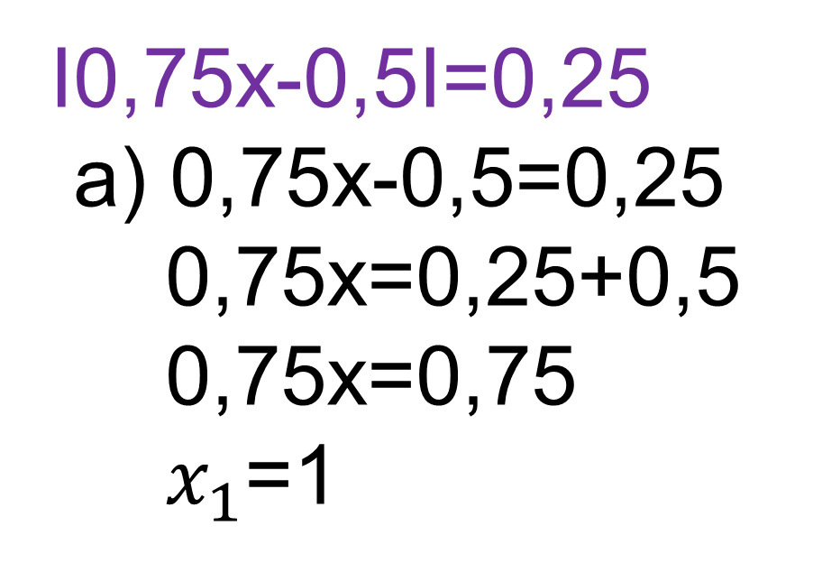

Modulli chiziqli tenglamalar:
I0,75x-0,5I=0,25
a) 0,75x-0,5=0,25
0,75x=0,25+0,5
0,75x=0,75
$x_{1}$=1
b)0,75x-0,5=-0,25
0,75x=-0,25+0,5
0,75x=0,25
$x_{2}$= $\frac{1}{3}$
Javob:$x_{1}$=1; $x_{2}$= $\frac{1}{3}$

Slide 15
Mustaqil bajarish uchun topshiriqlar:
Darslikning 5- betida joylashgan
16-,17- va 21-topshiriqlarni bajarish.

Slide 16
Qo‘shimcha masala
Karim ota 90 yoshda. Uning nabiralarining o‘rtacha yoshi 20 da. Nabiralar yoshlariga Karim ota yoshini ham qo‘shib, o‘rta arifmetik qiymat hisoblangan edi, u 22 ga teng chiqdi. Karim otaning nechta nabirasi bor?
Javob: 34 ta nabirasi bor.

