Slide 1
MATEMATIKA
5- sinf
MAVZU: SONNING KVADRATI VA KUBI

Slide 2
SONNING DARAJASI
7 + 7 + 7 + 7 + 7 + 7 = 7 · 6
4⁶
4 · 4 · 4 · 4 · 4 · 4 =
a · a · a · … · a = aᵇ
b ta

Slide 3
SONNING DARAJASI
Daraja asosi
Daraja ko‘rsatkichi
aᵇ
4⁶
Daraja

Slide 4
SONNING KVADRATI VA KUBI
a · a = a²
3² = 3·3 = 9
a · a · a = a³
2³ = 2 · 2 · 2=8

Slide 5
MISOLLAR
4² = 16
3³ = 27
7² = 49
5³ = 125
10² = 100
6³ = 216
11² = 121

Slide 6
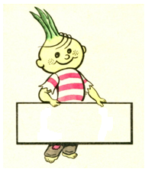
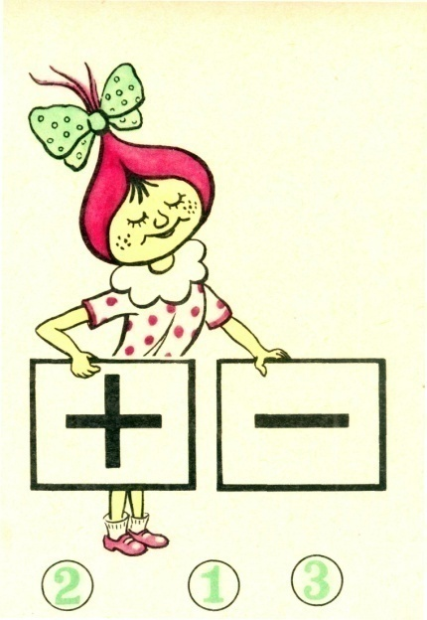
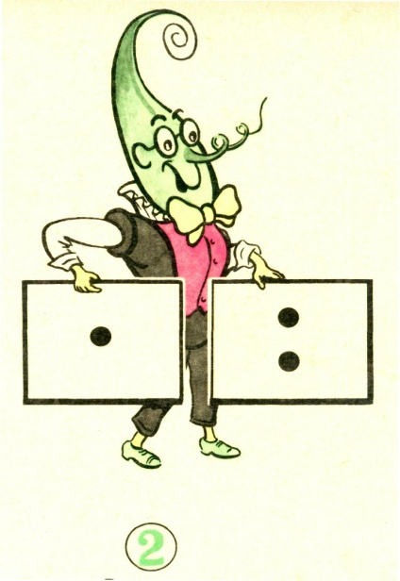
AMALLARNI BAJARILISH TARTIBI
III bosqich
daraja
I bosqich
II bosqich

Slide 7
MISOLLAR
1
4
2
5
3
1) 2³ + 3² - 4² =
8 + 9 – 16 = 1
2) 9³ - 6³ + 72 =
729 - 216 + 72 = 513 + 72 = 585
2
1
5
7
3
6
4
=(216 +13) • 2 – 16 • 9 =
3) (6³ + 13) • 2 - 2⁴ • 3²
= 229 • 2 – 144 = 458 – 144 = 314

Slide 8
343- masala
Daraja ko‘rinishida yozing:
a) 8 • 8 • 8 • 8 • 8 • 8 • 8 b) 24 • 24 • 24 • 24
d) x • x • x • x • x e) 5 • 5 • 5 • 5 • 5
f) 13 • 13 • 13 • 13 g) m • m • m • m
h) (x + 3) • (x + 3) • (x + 3) • (x + 3)
i) (6 - z) • (6 - z) • (6 - z)

Slide 9
YECHISH
a) 8 • 8 • 8 • 8 • 8 • 8 • 8
= 8⁷
b) 24 • 24 • 24 • 24
= 24⁴
d) x • x • x • x • x
= x⁵
h) (x + 3) • (x + 3) • (x + 3) • (x + 3)
= (x + 3)⁴
i) (6 - z) • (6 - z) • (6 - z)
= (6 - z)³

Slide 10
345- masala
Hisoblang:
a) 3² • 11
b) 5 + 6²
d) (3 + 5)²
e) (7³ - 3³) : (7 - 3)
f) (7 + 1)³
g) (8 - 5)³ : (8 - 5)
h) 6³ - 16
i) (9² - 2⁶) : 17 + 4²
= 9 • 11 = 99
= 5 + 36 = 41
= 8² = 64
= (343 - 27) : 4 = 316 : 4 = 79
= 8³ = 512
= 3³ : 3 = 9
= 216 - 16 = 200
= (81 – 64) : 17 + 16 = 17

Slide 11
347- masala
Tenglamaning ildizini toping:
x • x = 36 b) p • p = 81
d) y • y • y = 64 e) z • z • z • z • z = 1
f) m • m • m = 8 g) n • n • n • n = 81

Slide 12
350- masala
Ifodaning qiymatini toping:
4²
d) (10² - 2⁶) : 6 + 1¹⁰
e) 3² + 6²
f) 6³ - 5³
h) (40 : 4)⁵ - 100²
= 90 000
= 4 • 4 = 16
= (100 - 64) : 6 + 1 = 36 : 6 + 1 =7
= 9 + 36 = 45
= 216 – 125 = 91
= 10⁵ - 100² = 100 000 – 10 000 =

Slide 13
Mustaqil bajarish uchun topshiriqlar:
Darslikdagi 351-, 352-, 353-, 354- masalalarni yechish (75- bet).

