Slide 1
MATEMATIKA
5- sinf
MAVZU: TO‘RT AMALGA DOIR HISOBLASH ALGORITMLARI

Slide 2
OG‘ZAKI BAJARAMIZ
· 6
+ 70
: 5
· 8
30
180
50
400
250
- 180
5
20
220
: 4
: 11

Slide 3
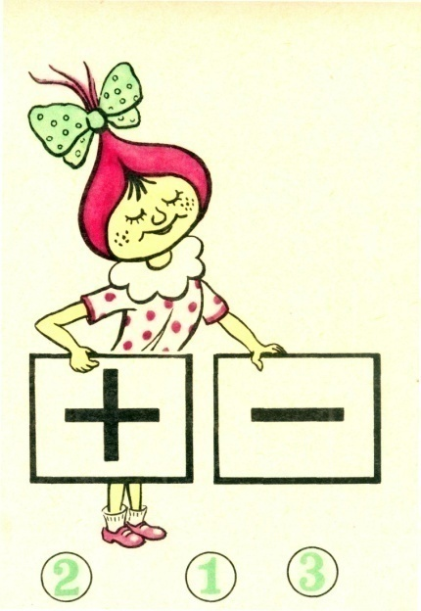
BIRINCHI BOSQICH AMALLARI
Qo‘shish va ayirish - I bosqich
amallari deyiladi.

Slide 4
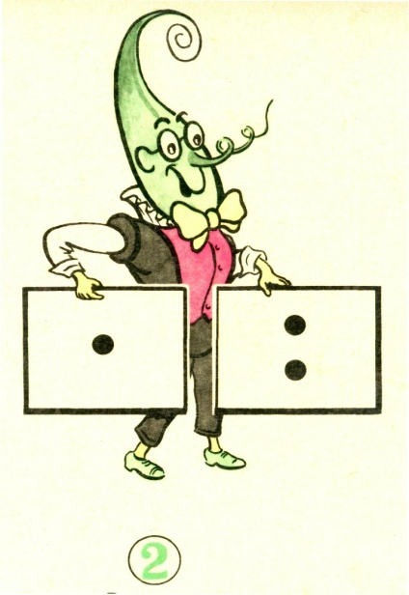
IKKINCHI BOSQICH AMALLARI
Ko‘paytirish va bo‘lish - II bosqich
amallari deyiladi.

Slide 5
ALGORITM
Agar ifodada qavslar bo‘lmasdan, faqat bitta bosqich amallari qatnashsa, amallar chapdan o‘ngga qarab yozilish tartibida ketma-ket bajariladi.
Biror topshiriqni ketma-ket bajarish tartibi yoki qoidasiga algoritm deyiladi.

Slide 6
MISOLLAR
Ifodaning qiymatini toping:
1
2
3
2
3
410 - 324 + 306 - 201 =
86 + 306 – 201=
3
= 392 – 201=
191
1
2
3
2
3
2) 640 : 32 • 56 : 28
= 20 • 56 : 28 =
3
= 1120 : 28 =
40

Slide 7
AMALLARNING BAJARILISH TARTIBI
Agar ifodada qavslar bo‘lmasdan, har ikkala bosqich amallari ham qatnashsa, oldin II bosqich amallari, so‘ng I bosqich amallari bajariladi.
II
bosqich
I
bosqich

Slide 8
MISOL
Amallarni bajaring:
136 - 28 : 7 + 12 · 6
3
1
4
2
3
4
= 136 – 4 + 72 =
4
= 132 + 72
= 204

Slide 9
MISOL
Amallarni bajaring:
(804 · 6 + 312 · 9) : 36
1
3
2
4
Agar ifodada qavslar qatnashgan bo‘lsa, oldin qavslar ichidagi amallar, so‘ng boshqa amallar 1- va 2- qoidalarga ko‘ra bajariladi.

Slide 10
MISOL
Amallarni bajaring:
(804 · 6 + 312 · 9) : 36 =
1
3
2
4
212
4) 7632
36
1) 804
2) 312
3) 4824
72
212
x
x
+
43
6
9
2808
36
4824
2808
7632
72
72
0

Slide 11
BILIB OLING
Agar ifodadagi qavslarni tashlab yuborish amallarning bajarilish tartibiga ta’sir qilmasa, unda qavslarni tashlab yuborish mumkin.
(49 + 23) - 39 = 49 + 23 - 39
Ifodalarning qiymatini hisoblayotganda qo‘shish, ayirish va ko‘paytirish amallarining xossalaridan foydalanish qulay va maqsadga muvofiq bo‘lsa, amallarni bajarish tartibi qoidalaridan chetga chiqish ham mumkin.

Slide 12
321- masala
Ifodadagi amallarni bajarish algoritmini aniqlang va uning qiymatini toping:
78 - 45 + 54 - 49
b) 231 + 112 - 223 - 109
d) 721 : 7 - 112 : 8 + 37 • 22
e) 322 : 23 • 22 - 483 • 9 : 23
f ) 315 : (375 - 24 • 15) + 98
g) (24 • 7 - 676 : 13) • 13 - 238

Slide 13
YECHISH
1
4
2
5
3
4
5
d) 721 : 7 - 112 : 8 + 37 • 22
= 103 – 14 + 814=
= 89 + 814 = 903
1
3
2
4
5
3
4
5
g) (24 • 7 - 676 : 13) • 13 - 238
=(168 - 52) • 13 – 238=
= 116 • 13 – 238
= 1508 – 238 = 1270

Slide 14
YECHISH
1
2
5
3
4
e) 322 : 23 • 22 - 483 • 9 : 23
= 119
1) 322
23
2) 14
3) 483
4) 4347
23
x
x
23
14
22
9
23
189
92
28
204
4347
92
28
184
0
308
207
5) 308
207
-
189
0
119

Slide 15
324- masala
Qo‘shish va ayirish xossalariga tayangan holda ifodaning qiymatini qulay usulda hisoblang:
a) 1278 + 432 + 568 b) 123 • 4 • 25
d) 2132 + 231 - 132 e) 32 • 17 + 68 • 17
f) 708 - 342 - 208 g) 786 • 115 - 86 • 115

Slide 16
YECHISH
a) 1278 + 432 + 568
= 1278 + (432 + 568) =
= 1278 + 1000 = 2278
b) 123 • 4 • 25
= 123 • (4 • 25) =
12 300
100 • 123 =
d) 2132 + 231 - 132
= (2132 + 231) – 132 =
= (2132 -132) + 231
= 2000 + 231 = 2231

Slide 17
Mustaqil bajarish uchun topshiriqlar:
Darslikdagi 325-, 326-, 327- masalalarni yechish (72- bet).

