Slide 1
MATEMATIKA
5- sinf
MAVZU: O‘TILGAN MAVZULARNI TAKRORLASHGA DOIR MASALALAR

Slide 2
TOPSHIRIQ
Quyidagi jumlalarni o‘qing. Jumla to‘g‘ri bo‘lsa “+”, noto‘g‘ri bo‘lsa “-” belgisini yonidagi katakka qo‘ying.
+
Ko‘paytuvchilar o‘rnini almashtirgan bilan ko‘paytma o‘zgarmaydi.
Har qanday sonni 1 ga ko‘paytirganda yana 1 hosil bo‘ladi.
Noma’lum bo‘linuvchini topish uchun bo‘linmani bo‘luvchiga ko‘paytirish kerak.
Har doim qoldiq bo‘luvchidan kichik bo‘ladi.
Nolni har qanday natural songa bo‘lganda yana o‘sha sonning o‘zi hosil bo‘ladi.
-
+
+
-

Slide 3
294- masala
Ifodaning qiymatini toping:
a) 210 + 210 + 210 + 210 + 4571
b) 88 + 88 + 88 + 333 + 333 + 333
d) 523 + 523 + 3278 + 523 + 3278
e) 6530 + 153 + 153 + 6530 +153 + 153

Slide 4
YECHISH
a) 210 + 210 + 210 + 210 + 4571
= 210 • 4 + 4571=
= 840 + 4571 = 5411
d) 523 + 523 + 3278 + 523 + 3278
= 523 • 3 + 3278 • 2 =
= 1569 + 6556 = 8125
e) 6530 + 153 + 153 + 6530 +153 + 153 =
= 153 • 4 + 6530 • 2 =
= 612 + 13060 = 13672

Slide 5
295- masala
Guruhlash qonunidan foydalanib, ko‘paytmani hisoblang.
a) 25 • (4 • 7709) b) (200 • 13) • 5
d) 8 • (125 • 333) e) (1010 • 4) • 25

Slide 6
YECHISH
a) 25 • (4 • 7709)
=(25 • 4) • 7709 =
100 • 7709 =
770900
b) (200 • 13) • 5
=(200 • 5) • 13 =
1000 • 13 =
13000
d) 8 • (125 • 333)
=(8 • 125) • 333 =
1000 • 333 =
333000

Slide 7
297- masala
Agar a = 21, b = 36 bo‘lsa, 55a - 3b ifodaning qiymatini toping.
Yechish:
a = 21, b = 36, 55a - 3b =
55 • 21 – 3 • 36 =
= 1155 – 108 = 1047
Javob: 1047

Slide 8
299- masala
ABC uchburchakning AB tomoni 234 mm va u AC tomondan 5 marta qisqa. Agar uchburchak perimetri 2450 mm bo‘lsa, BC tomon uzunligini toping.
B
?
234 mm
A
C
5 marta uzun

Slide 9
YECHISH
Berilgan:
B
AB = 234 mm
AC – 5 marta uzun
P = 2450 mm
BC=?
?
234 mm
C
A
5 marta uzun
Yechish: AC = 234 • 5 = 1170 (mm)
P = AB + AC + BC
BC = P – (AB + AC) = 2450 – (234 + 1170) =
= 2450 – 1404 = 1046(mm)
Javob: 1046 mm

Slide 10
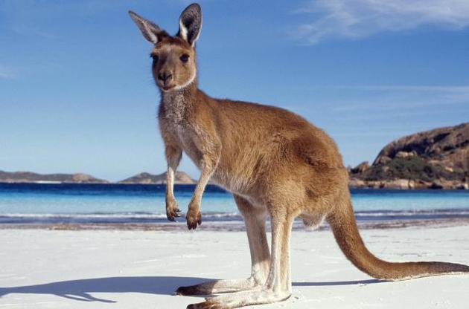
301- masala
Kenguru soatiga 48 km tezlikda yugurishi mumkin. a) Kenguru
1 soatda necha metrga yugurishi mumkin? 1 minutda-chi?
b) U 12 km masofani qancha vaqtda bosib o‘tadi?
d) U 30 sekundda qancha masofani bosib o‘tadi? 5 minutda-chi?

Slide 11
YECHISH
a) 1 soatda: 48 km = 48000 m
1 minutda: 1 soat = 60 minut, 48000 : 60 = 800(m)
b) 12 km masofani: 12 km = 12000m
12000 : 800 = 15 (min)
d) 30 sekundda: 800 : 2 = 400 (m)
5 minutda: 800 • 5 = 4000(m),

Slide 12
304- masala
Tenglamani yeching:
a) 33 • x = 1386 b) 454 • a = 55 842
d) x : 19 = 13 e) a : 119 = 314
f) 26 289 : x = 127 g) 42 745 : m = 415

Slide 13
YECHISH
33 • x = 1386
x = 1386 : 33
x = 42
e) a : 119 = 314
a = 314 • 119
a = 37 366
f) 26 289 : x = 127
x = 26 289 : 127
x = 207
g) 42 745 : m = 415
m = 42 745 : 415
m = 103

Slide 14
306- masala
Shunday sonni topingki, uni:
a) 17 ga bo‘lganda, 88 hosil bo‘lib, 11 qoldiq qolsin;
b) 231 ga bo‘lganda, 121 hosil bo‘lib, 133 qoldiq qolsin.
Yechish:
a) 17 • 88 +11
= 1496 + 11 = 1507
b) 231 • 121 +133
= 27 951 + 133 = 28 084
Javob: a) 1507, b) 28 084

Slide 15
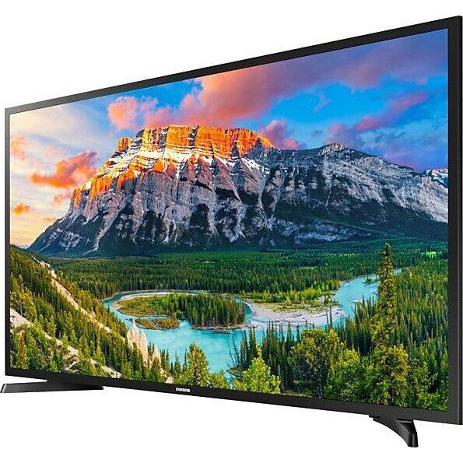
308- masala
Birinchi konveyerda 1 soatda 25 ta, ikkinchi konveyerda esa 31 ta televizor yig‘iladi. Ikkala konveyerda 8 soat davomida qancha televizor yig‘iladi?
Yechish:
a) 25 • 8 +31 • 8
= 8 • (25 + 31) = 8 • 56 = 448
Javob: 448 ta

Slide 16
309- masala
Ifodani soddalashtiring:
a) 109d + 443 + 273d + 279
b) 332t + 211t + 999 + 677
d) 34 + 139c + 257 + 61c
e) 1786 - 903 + 430q + 453q

Slide 17
YECHISH
a) 109d + 443 + 273d + 279 =
= (443 + 279) + (109 + 273)d = 722 + 382d
b) 332t + 211t + 999 + 677 =
= (332 + 211)t + (999 + 677) = 543t + 1676
e) 1786 - 903 + 430q + 453q
= 883+ (430 + 453)q = 883 + 883q

Slide 18
Mustaqil bajarish uchun topshiriqlar:
Darslikdagi “Yutuqlaringizni tekshirib ko‘ring” rukni ostida berilgan test va topshiriqlarni yechish (65- bet).

