Slide 1
MATEMATIKA
5- sinf
MAVZU: MASALALAR YECHISH

Slide 2
KO‘PAYTIRISHNING TAQSIMOT QONUNLARI
Qavslarni ochish:
(a + b) • c = a • c + b • c
(a – b) • c = a • c – b • c
Umumiy ko‘paytuvchini qavsdan tashqariga chiqarish:
a • c + b • c = (a + b) • c
a • c – b • c = (a – b) • c

Slide 3
281- masala
Tenglamani yeching.
a) 3x + 4x + 17 = 24 b) 8y + 56 + 4y = 80
d) 11p - 4p - 25 = 24 e) 18d + 5d - 23 = 23

Slide 4
YECHISH
d) 11p - 4p - 25 = 24
11p – 4p = (11- 4)p = 7p
7p - 25 = 24
7p = 24 + 25
7p = 49
p = 49 : 7
p = 7
e) 18d + 5d - 23 = 23
18d + 5d = (18 + 5)d = 23d
23d - 23 = 23
23d = 23 + 23
23d = 46
d = 46 : 23
d = 2

Slide 5
282- masala
2-rasmdagi qaysi holda arzon xarid amalga oshiriladi?
1 donasi
15 800 so‘m
2 donasi
31 000 so‘m
Yechish:
31 000 : 2 = 15 500,
15 800 >15 500
Javob: 2 ta xarid qilganda

Slide 6
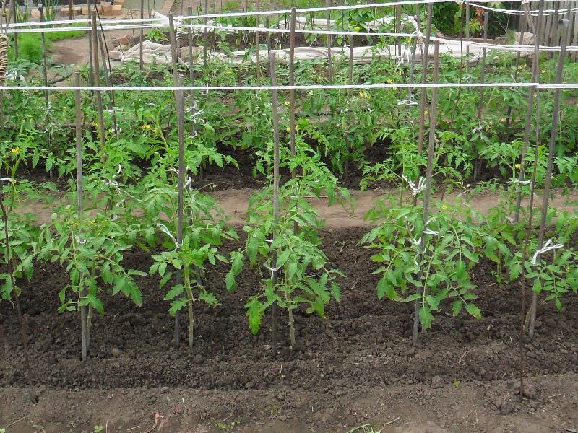
283- masala
7 qatorning har biriga 24 tadan pomidor ko‘chati ekildi. So‘ng bu qatorlarning har biriga yana 8 tadan qo‘shimcha ko‘chat ekildi. Jami
necha tup ko‘chat ekilgan?
Yechish:
7 • 24 + 7 • 8 =
7 • (24 + 8) = 7 • 32=
210 + 14 = 224
Javob: 224 tup

Slide 7
284- masala
Saodat bir son o‘yladi. Uni oldin 15 ga ko‘paytirdi, so‘ng uni alohida yana 45 ga ko‘paytirdi. Natijalarni qo‘shganda 1500 hosil bo‘ldi. Saodat qaysi sonni o‘ylagan?
Yechish:
15x + 45x =1500
15x + 45x = 60x
60x =1500
x = 25
Javob: 25

Slide 8
285- masala
3-rasmdan foydalanib tenglama tuzing va noma’lumning massasini toping:
x
x
1 kg
1 kg
1 kg
5 kg
1 kg
1 kg
1 kg
1 kg
1 kg
1 kg
1 kg
2 kg
2 kg
1 kg
1 kg
Yechish:
a) 2 + x = 6
b) 9 = 4 + x
x = 6 - 2
x = 4
x = 9 - 4
x = 5

Slide 9
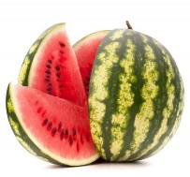
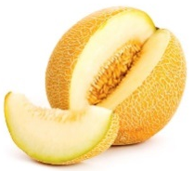
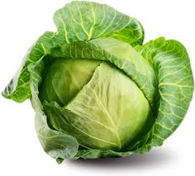
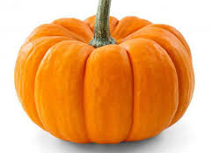
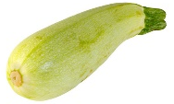
286- masala
Diagrammadagi ma’lumotlardan foydalanib,
quyidagi savollarga javob bering:
kg
6
a) Bittadan olingan poliz mahsulotlarining jami massasi qancha?
b) 6 ta qovoq va 3 ta qovunning massasi qancha?
d) Bitta qovoqning massasi nechta tarvuz massasiga teng?
e) Masala tuzing va uni yeching.
4
2

Slide 10
286- masala
kg
b) 6 ta qovoq va 3 ta qovunning
massasi qancha?
Yechish:
6 ∙ 6 + 3 ∙ 4 = 36 + 12 = 48 (kg)
Javob: 48 kg
d) Bitta qovoqning massasi nechta tarvuz massasiga teng?
Yechish:
6 kg = 3kg ∙ 2
Javob: 2 ta
6
4
2

Slide 11
293- masala
6-rasmdagi yo‘lovchi kemasi 6 soatda 300 km suzdi. Agar yuk kemasining tezligi yo‘lovchi kemasi tezligidan 20 km/h kam bo‘lsa, bu vaqt ichida yuk kemasi qancha masofani bosib o‘tadi? Masalani sxemada ko‘rsatilgan ketma-ketlikda yeching.

Slide 12
YECHISH
Yo‘lovchi kemasi
Masofa – 300 km
Vaqt – 6 soat
Tezlik - ?
Yuk kemasi
Masofa – ? km
Vaqt – 6 soat
Tezlik – 20 km/h kam?
3
1
2

Slide 13
YECHISH
Yo‘lovchi kemasi
Masofa – 300 km
Vaqt – 6 soat
Tezlik - ?
Yuk kemasi
Masofa – ? km
Vaqt – 6 soat
Tezlik – 20 km/h kam?
3
1
2
Yechish:
1) 300 : 6 = 50 (km/h)
2) 50 – 20 = 30 (km/h)
3) 30 ∙ 6 = 180 (km)
Javob: 180 km

Slide 14
Mustaqil bajarish uchun topshiriqlar:
Darslikdagi 287-, 288-, 289-,
290-, 292- masalalarni yechish
(63- bet).

