Slide 1
ENGLISH
Grade
5
THEME:
I like English. And you?

Slide 2
Checking the self-study work
1. Answer the questions.
p.103 Unit 5 L5
1. When do children in Uzbekistan go to school?
2. How many lessons do you usually have?
3. How many big breaks do you have?
4. What do you do in the afternoon?
5. Do you wear a uniform?
They usually go to school from Monday to Saturday.
We usually have 5 or 6 lessons a day.
We have one big break.
We usually go to sports clubs in the afternoon.
Yes, we do.

Slide 3
Checking the self-study work
p.103 Unit 5 L5
2. Write 2 true and 2 false sentences about schools in Germany.
1. In Germany children go to school 5 days a week.
2. In Germany pupils wear uniform.
3. In Germany lessons are 45 minutes long.
4. In Germany there is one big break.

Slide 4
Listen to the song and sing it.

Slide 5
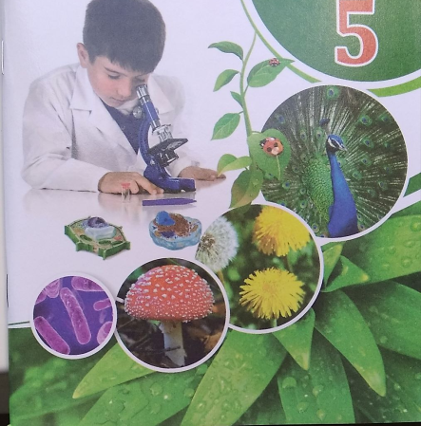
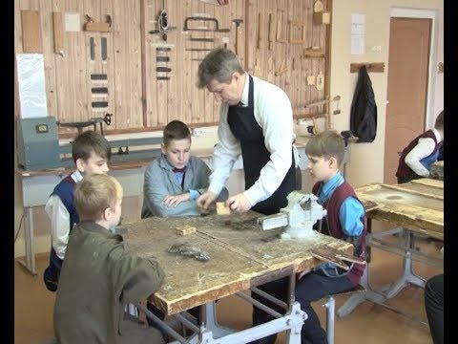
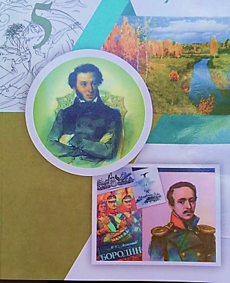
Ask and answer. Is it Literature? Yes, it is/ No, it is not.
2
1
3
biology
handicrafts
4
literature
geography

Slide 6
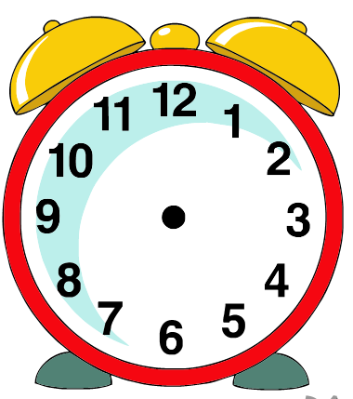
Listen and guess the picture
A
C
B
B
D
It’s a quarter past nine.

Slide 7
Listen and guess the picture
A
C
B
D
D
It’s half past two.

Slide 8
Listen and guess the picture
A
C
A
B
D
It’s a quarter to seven.

Slide 9
Listen and guess the picture
C
A
C
B
D
It’s a quarter past three.

Slide 10
Read and choose Midday or Midnight
People usually sleep.
midday
midnight

Slide 11
Read and choose Midday or Midnight
People usually eat.
midday
midnight

Slide 12
For self-study
Prepare short text on the topic “My school”.

